Slide 1




Slide 2
The Sage Project model
Connect existing faculty teaching existing courses with existing projects to real-world projects that address social, economic, and environmental goals for the Lemon Grove community
Notes:
Thousands of students eager to tackle meaningful projects
Faculty experts (researchers, industry professionals)
Pursuit of knowledge is what universities are all about
Researchers and industry professionals, not only teaching and doing research, but actively engaged in the community as civil engineers, city planners, graphic designers, real estate analysts etc.

Slide 3
The Sage Project mission
Students engage in meaningful, real-world projects and make positive contributions to communities in SDSU’s service area
City gets creative ideas, designs, solutions, and resources that create momentum for moving projects forward
Notes:
high-impact practices
future leaders who are knowledgeable about Santee and may be employed in your community and/or by your city

Slide 4
Transforming knowledge to practice
Universities offer…
Thousands of students eager to tackle meaningful projects
Faculty experts (researchers, industry professionals)
Unlimited access to new knowledge
Innovation
Notes:
Pursuit of knowledge is what universities are all about
Researchers and industry professionals, not only teaching and doing research, but actively engaged in the community as civil engineers, city planners, graphic designers, real estate analysts etc.
We want to harness these resources and focus them on a single community -- SANTEE
Students can take risks, propose multiple innovative ideas towards the same projects. Some of these can be dismissed by the city as ‘just student work’, or, more often, they get conversations started, projects unstuck.
The City benefits, students/faculty benefit

Slide 5
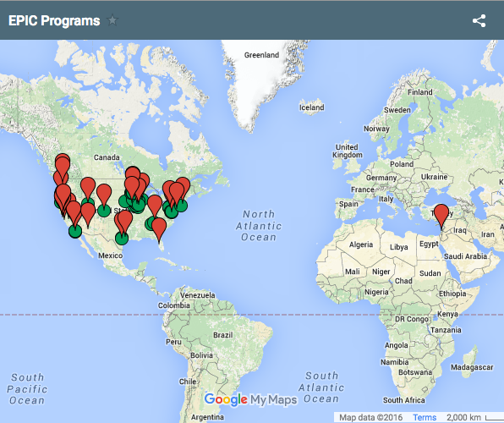
The EPIC Network
Educational Partnerships for Innovation in Communities (EPIC) Network
Approximately 30 programs across the US (and one in Israel)
Network members serve as resources for each other and prospective members
Notes:
Underway or in development of adaptation of model
Successes are shared
While it’s common for the general public to have some knowledge of San Diego, now everyone in the network knows about National City, Tijuana, Santee, and now Lemon Grove. This positive recognition goes beyond the local level to national and international audiences.
BONN conference

Slide 6


The Sage Project @ SDSU replication
Launched in 2013
First in California
Four community partners
Lots of momentum

Slide 7
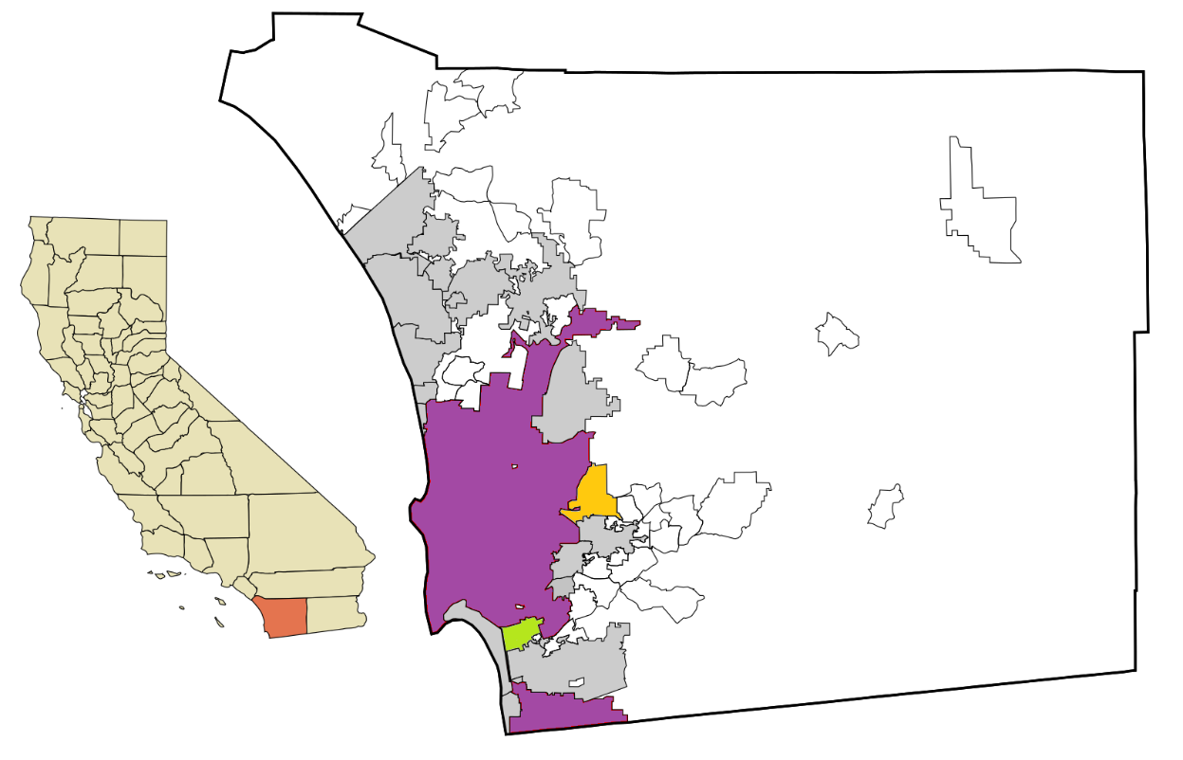
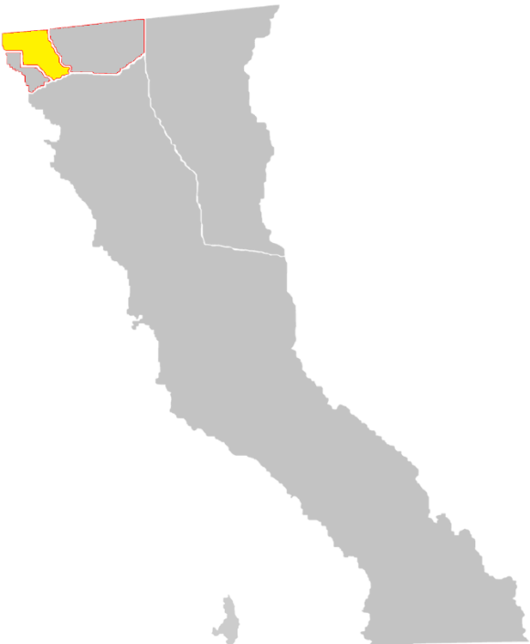
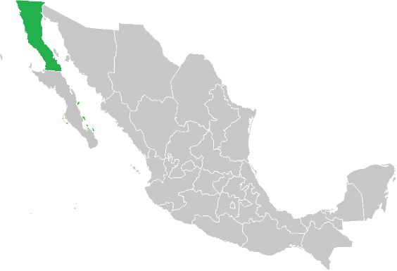

Community impact:
Partnerships
Tijuana
Santee
San Diego
National City
Retrieved and adapted from Arkyan [GFDL (http://www.gnu.org/copyleft/fdl.html), CC-BY-SA-3.0 (http://creativecommons.org/licenses/by-sa/3.0/) or CC BY-SA 2.5-2.0-1.0 (http://creativecommons.org/licenses/by-sa/2.5-2.0-1.0)], via Wikimedia Commons; [GFDL (http://www.gnu.org/copyleft/fdl.html) or CC BY-SA 3.0 (http://creativecommons.org/licenses/by-sa/3.0)], via Wikimedia Commons; By 08OceanBeach SD (Own work) [CC BY-SA 3.0 (http://creativecommons.org/licenses/by-sa/3.0)], via Wikimedia Commons

Slide 8
Impact since 2013
100,000+
hours of effort toward
local communities
2,400+ students
73
courses
43 faculty
28
disciplines
31 projects
3 years
1 univ
4 cities
Notes:
Per year:
10-15 projects
25 classes
9-10 disciplines
600+ students
Tens of thousands of hours of effort toward a single community
This is a win-win-win
Benefits students
Brings positive attention to the university and the community
Prepares students to address challenges of our future
Prepares them to be our future leaders.

Slide 9

And now City of Lemon Grove!
Lemon Grove
Retrieved and adapted from Arkyan [GFDL (http://www.gnu.org/copyleft/fdl.html), CC-BY-SA-3.0 (http://creativecommons.org/licenses/by-sa/3.0/) or CC BY-SA 2.5-2.0-1.0 (http://creativecommons.org/licenses/by-sa/2.5-2.0-1.0)], via Wikimedia Commons; [GFDL (http://www.gnu.org/copyleft/fdl.html) or CC BY-SA 3.0 (http://creativecommons.org/licenses/by-sa/3.0)], via Wikimedia Commons; By 08OceanBeach SD (Own work) [CC BY-SA 3.0 (http://creativecommons.org/licenses/by-sa/3.0)], via Wikimedia Commons

Slide 10
Lemon Grove’s Proposed Projects
Homeless Outreach Resources
Image Development
Infrastructure Maintenance
Parks and Recreation Programming
Place-Making
Public Art
Tactical Urbanism
Notes:
With 7 projects, we’re looking at 10-20 courses, enrolling 30+ students each, or around 300-600 students, dedicated together tens of thousands of hours of effort towards Lemon Grove.

Slide 11
Deliverables
Research, designs, solutions, resources, and recommendations based on cutting-edge research and current best practices to help advance stagnant projects
The City decides if, when, and how to implement this work
Notes:
This is the return on the investment.
Usually in the form of a professionally prepared report
We are pre-consultant consultants. We provide an abundance of information and ideas, some of them highly innovative and coming from a variety of disciplines,, and the City then decides what they want to do. We don’t replace consultants, we help you move forward to that next step.
And we take risks so you don’t have to.
So we provide the ideas, you decide how to act.

Slide 12
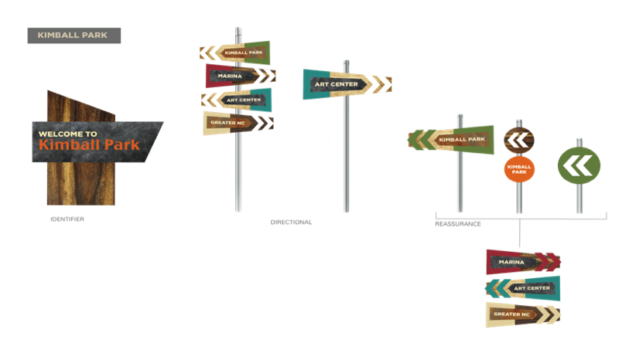
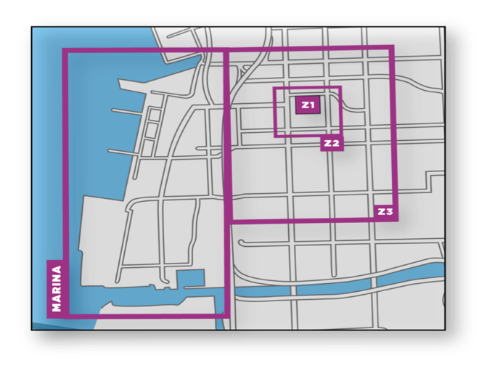
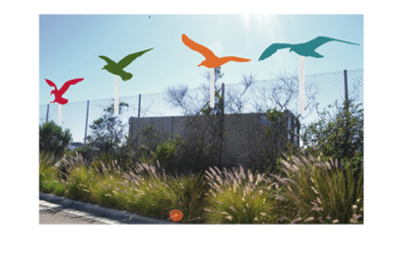
National City:
Wayfinding system
Helped the City obtain $1.1 million in wayfinding grants
Disciplines: geography, graphic design

Slide 13
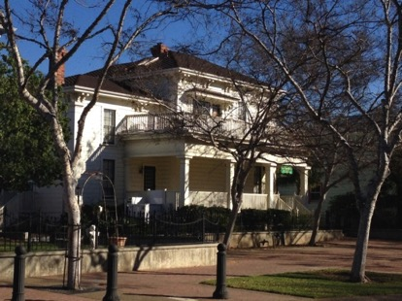
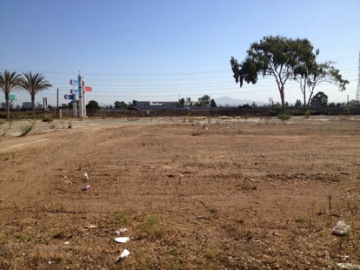
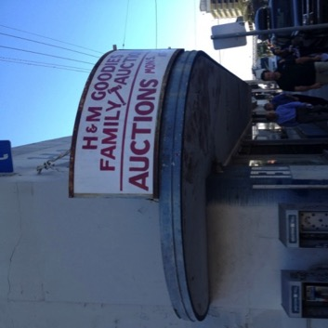
National City:
Property management plan
Determine highest and best use for City’s assets for development of a Long-Range Property Management Plan
Disciplines: real estate & finance, sustainability, geography, and city planning
Notes:
Submitted by the City last September, using approximately 80% of what students generated.

Slide 14
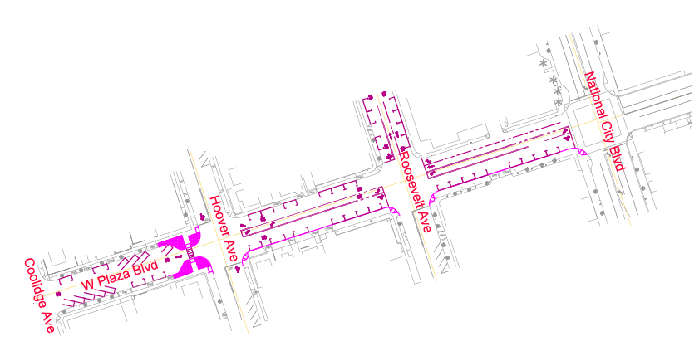
National City:
Downtown “Green Streets”
Redesign a street to redirect, slow, and relieve traffic flow; enhance walkability; address stormwater runoff; and create landscaping improvements featuring drought-tolerant plants
Discipline: civil engineering

Slide 15
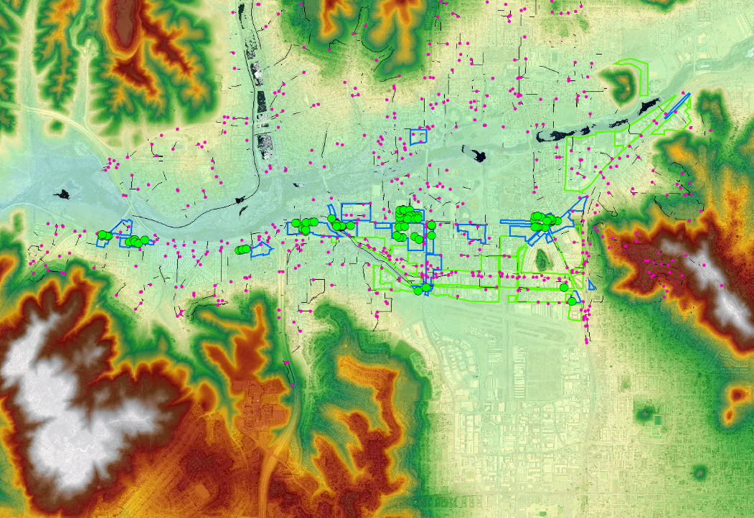
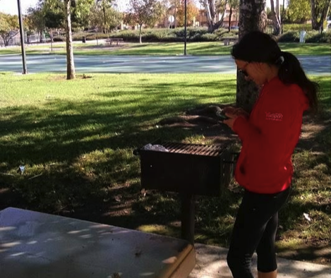
City of Santee:
GIS / Asset Mapping
Collected data and create GIS data layers of park assets and facilities for nine city parks, private stormwater inlets, and missing sidewalks and pedestrian ramps
  Disciplines: civil engineering, geography
Over 2,000 data points covering 69 hectares!
Notes:
GIS Layers provided to city
Worked with IT staff member to ensure they layers were compatible with existing capabilities

Slide 16
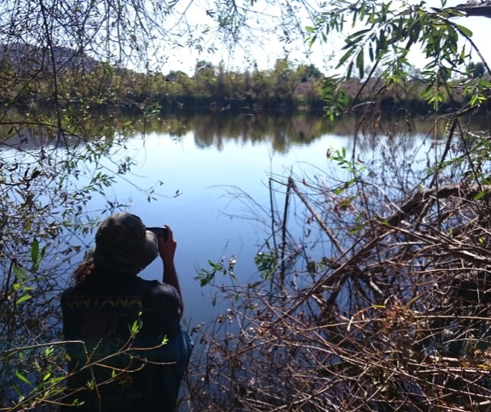
City of Santee:
Water Quality / Stormwater
Analyze water quality documentation, data, and land use layers to evaluate spatial and temporal patterns in water quality
  Disciplines: civil engineering,
  environmental engineering,
  geography
Notes:
Identified hotspots where alternative compliance measures needed in areas receiving flow, and provided recommendations for mitigation (e.g., moving water through soil, plants, etc., will likely decrease nutrient concentrations)

Slide 17
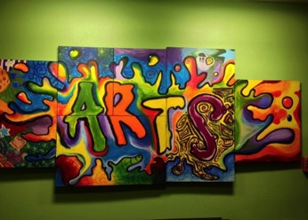
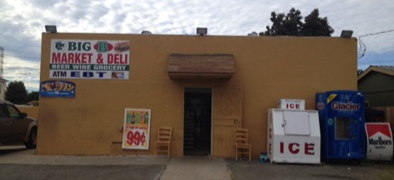

Added value:
Local and national partnerships
A Reason to Survive
Big B’s Market & Deli
Ecoparque
Head Start
National City Historical Society
Olivewood Gardens & Learning Center
Ocean Connectors
San Diego County
US Environmental Protection Agency
Notes:
Collaboration with, recognition from…
Capacity building

Slide 18
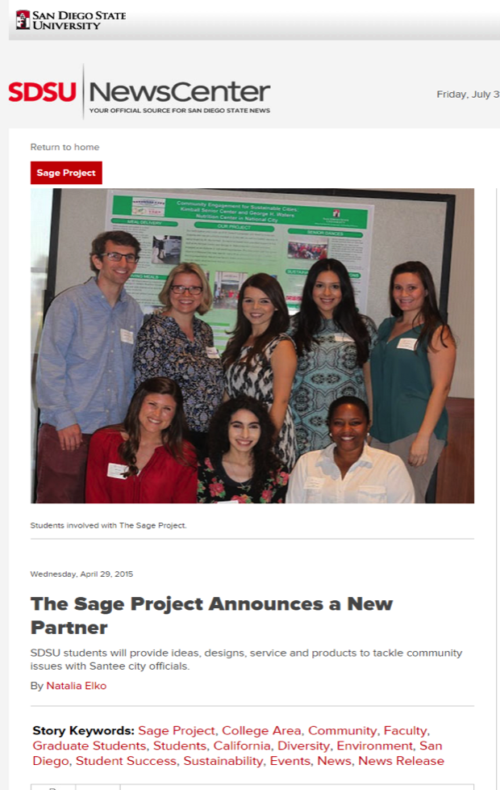
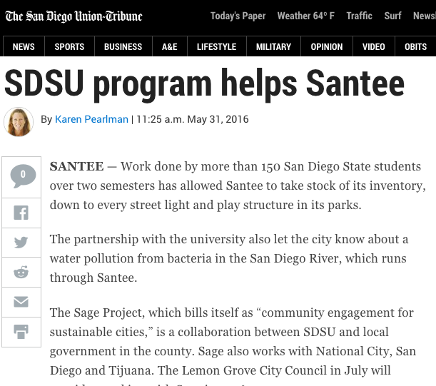
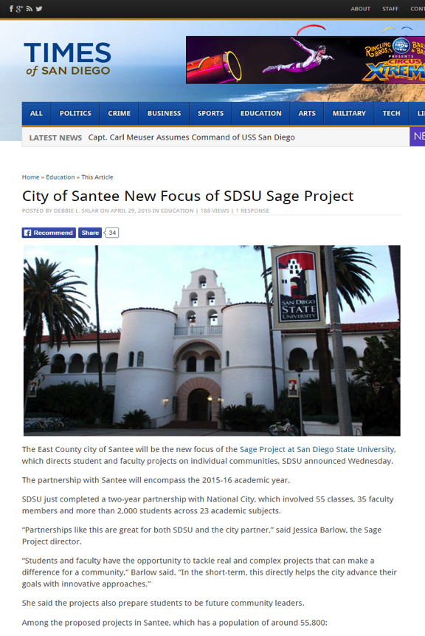
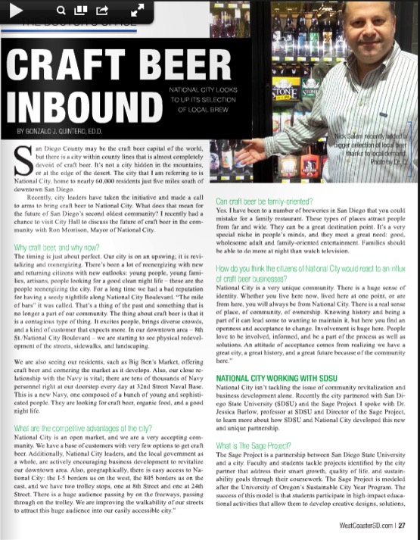
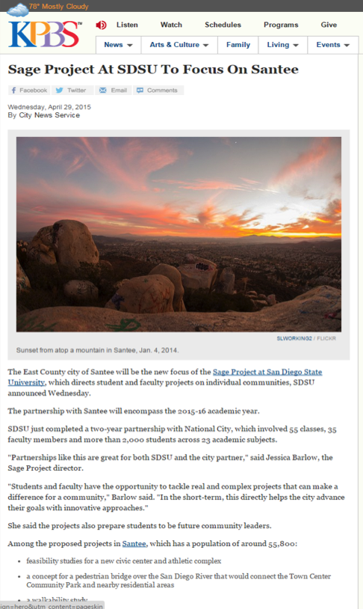
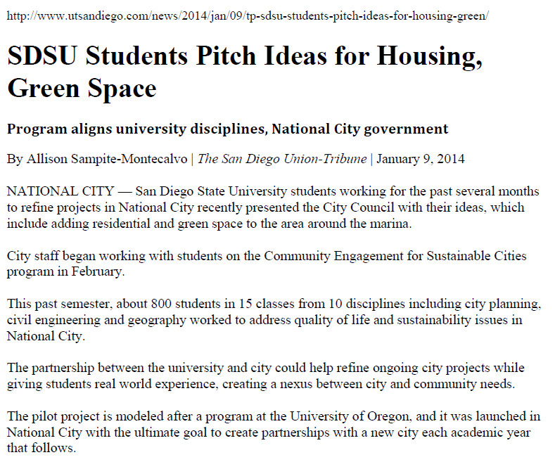
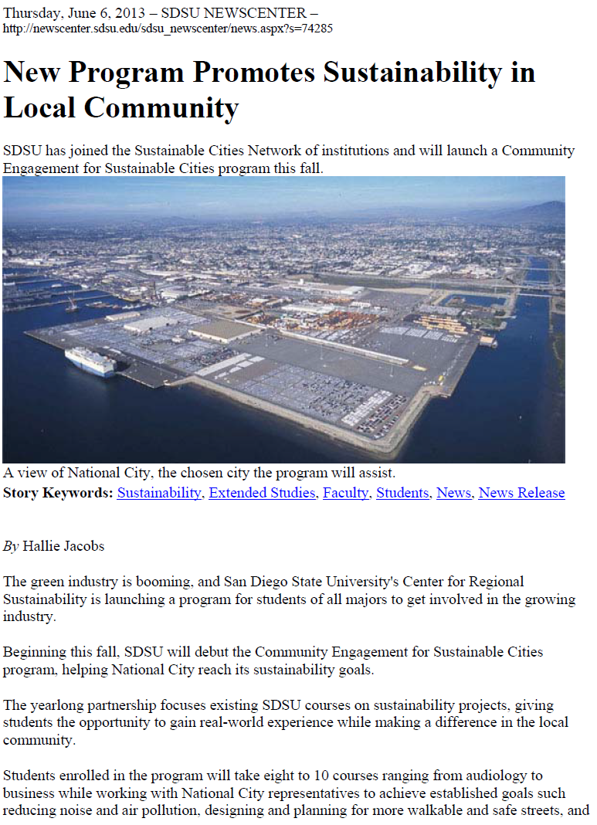
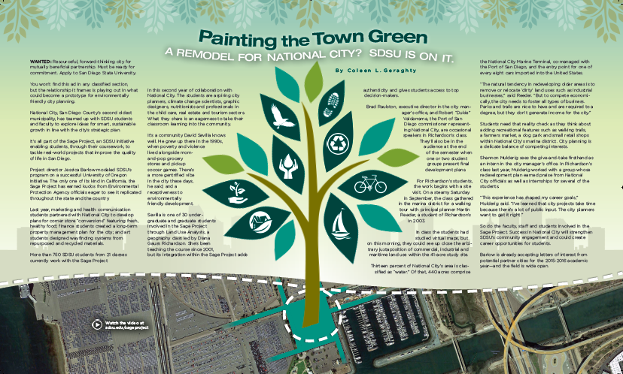
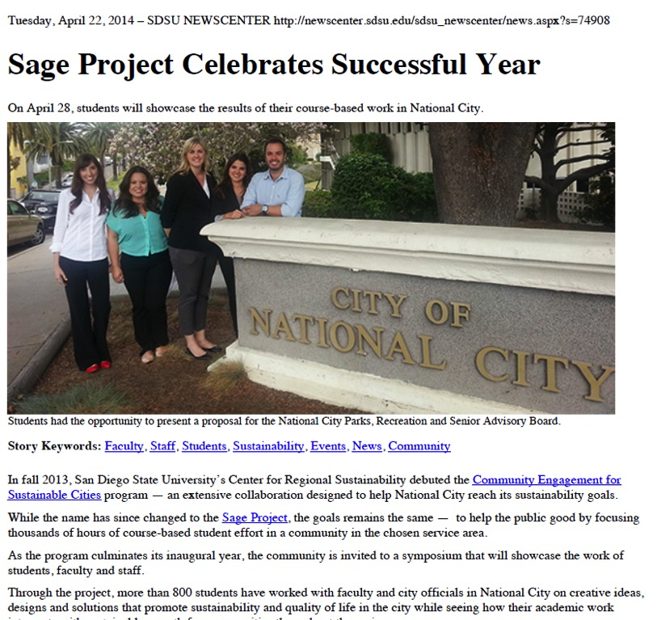
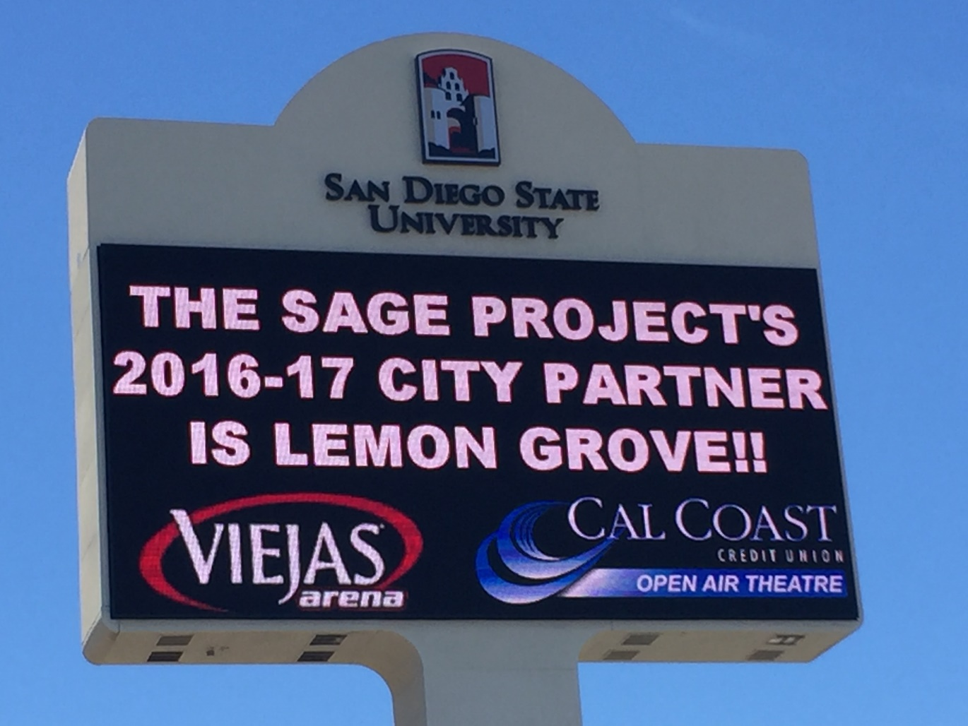
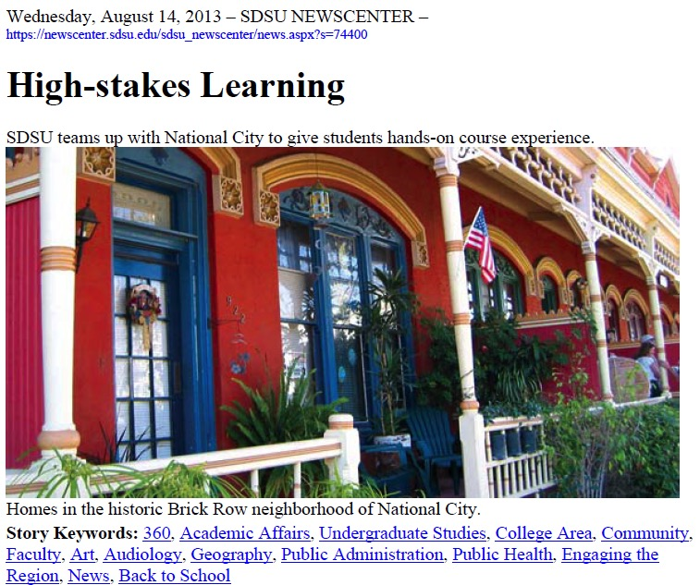
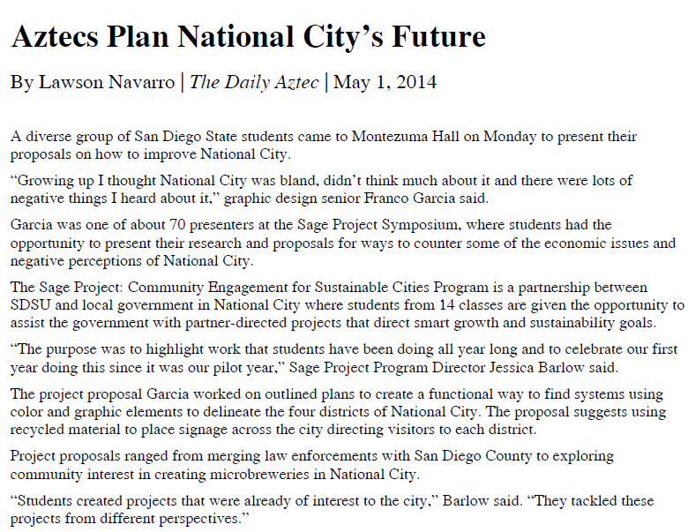
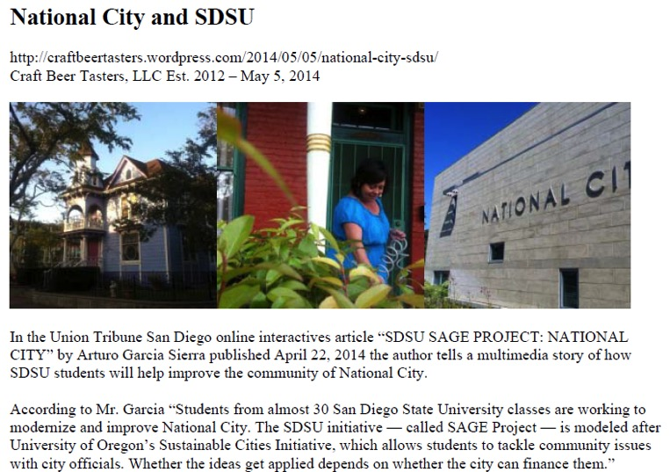
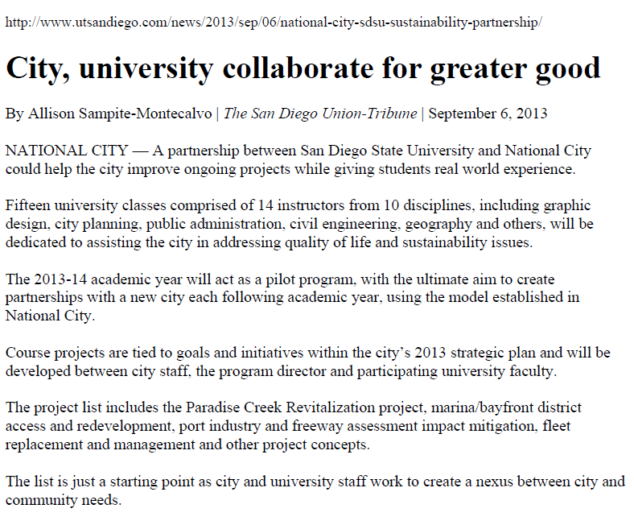
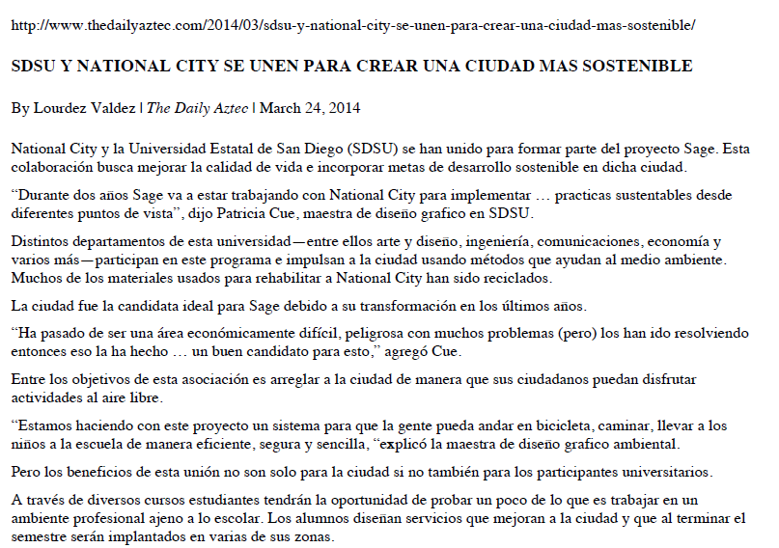
Our momentum:
Positive press

Slide 19

Thank you!
Contact:
Jessica Barlow, Director
The Sage Project
San Diego State University
619-594-3807
jessica.barlow@sdsu.edu sage.sdsu.edu

