Slide 1

Keeping Lemon Grove
Clean, Safe and Well-Maintained

Slide 2

Keeping Lemon Grove Clean, Safe, and Well-Maintained
A vibrant community nestled in San Diego County, Lemon Grove offers small-town charm with a zest for life. From citrus groves to cultural gems, the city offers a high quality of living.
The City of Lemon Grove maintains:
  70 miles of streets
  25 miles of storm drains
  14 acres of community parks and playfields
  Police, fire and paramedic services
  And more!

Slide 3
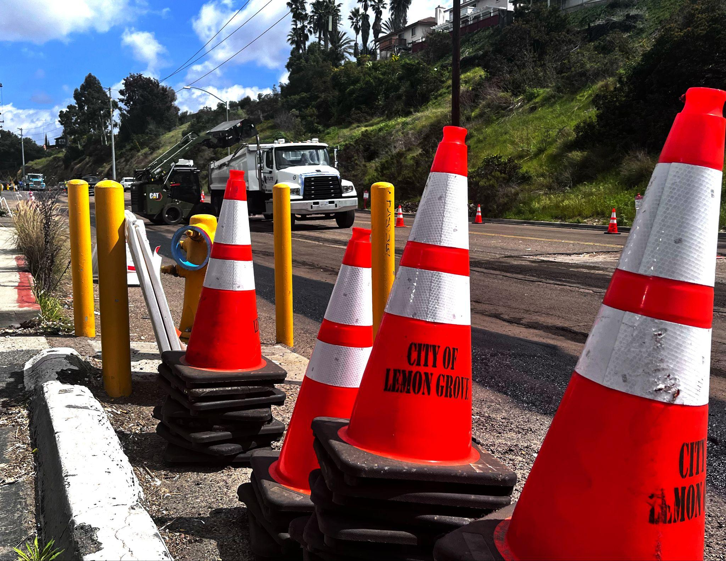
Providing Essential Services
Aging streets, sidewalks and 50-year-old underground storm drain pipes that carry rainwater are starting to fail, creating sinkholes and flooding that can damage streets and property.
Needed repairs are currently estimated at $171 million. The longer we wait to fix this problem, the more expensive it will become.

Slide 4
Local Funding Measure
Lemon Grove’s City Council voted to place a one-cent sales tax increase on the November 2024 ballot, providing $5.9 million annually, for these repairs and other essential City services, including:
Fix potholes and maintain streets
Keep local parks, sports fields, playgrounds, and community facilities safe, clean and well-maintained
Improve roads, intersections, bike lanes and signals to improve traffic safety and reduce congestion
Repair aging infrastructure, including storm drains, streets, sidewalks, curbs, and public facilities
Keep trash and pollution out of our local creeks and waterways
Provide fire protection and paramedic services, and quick response to 9-1-1 emergencies

Slide 5
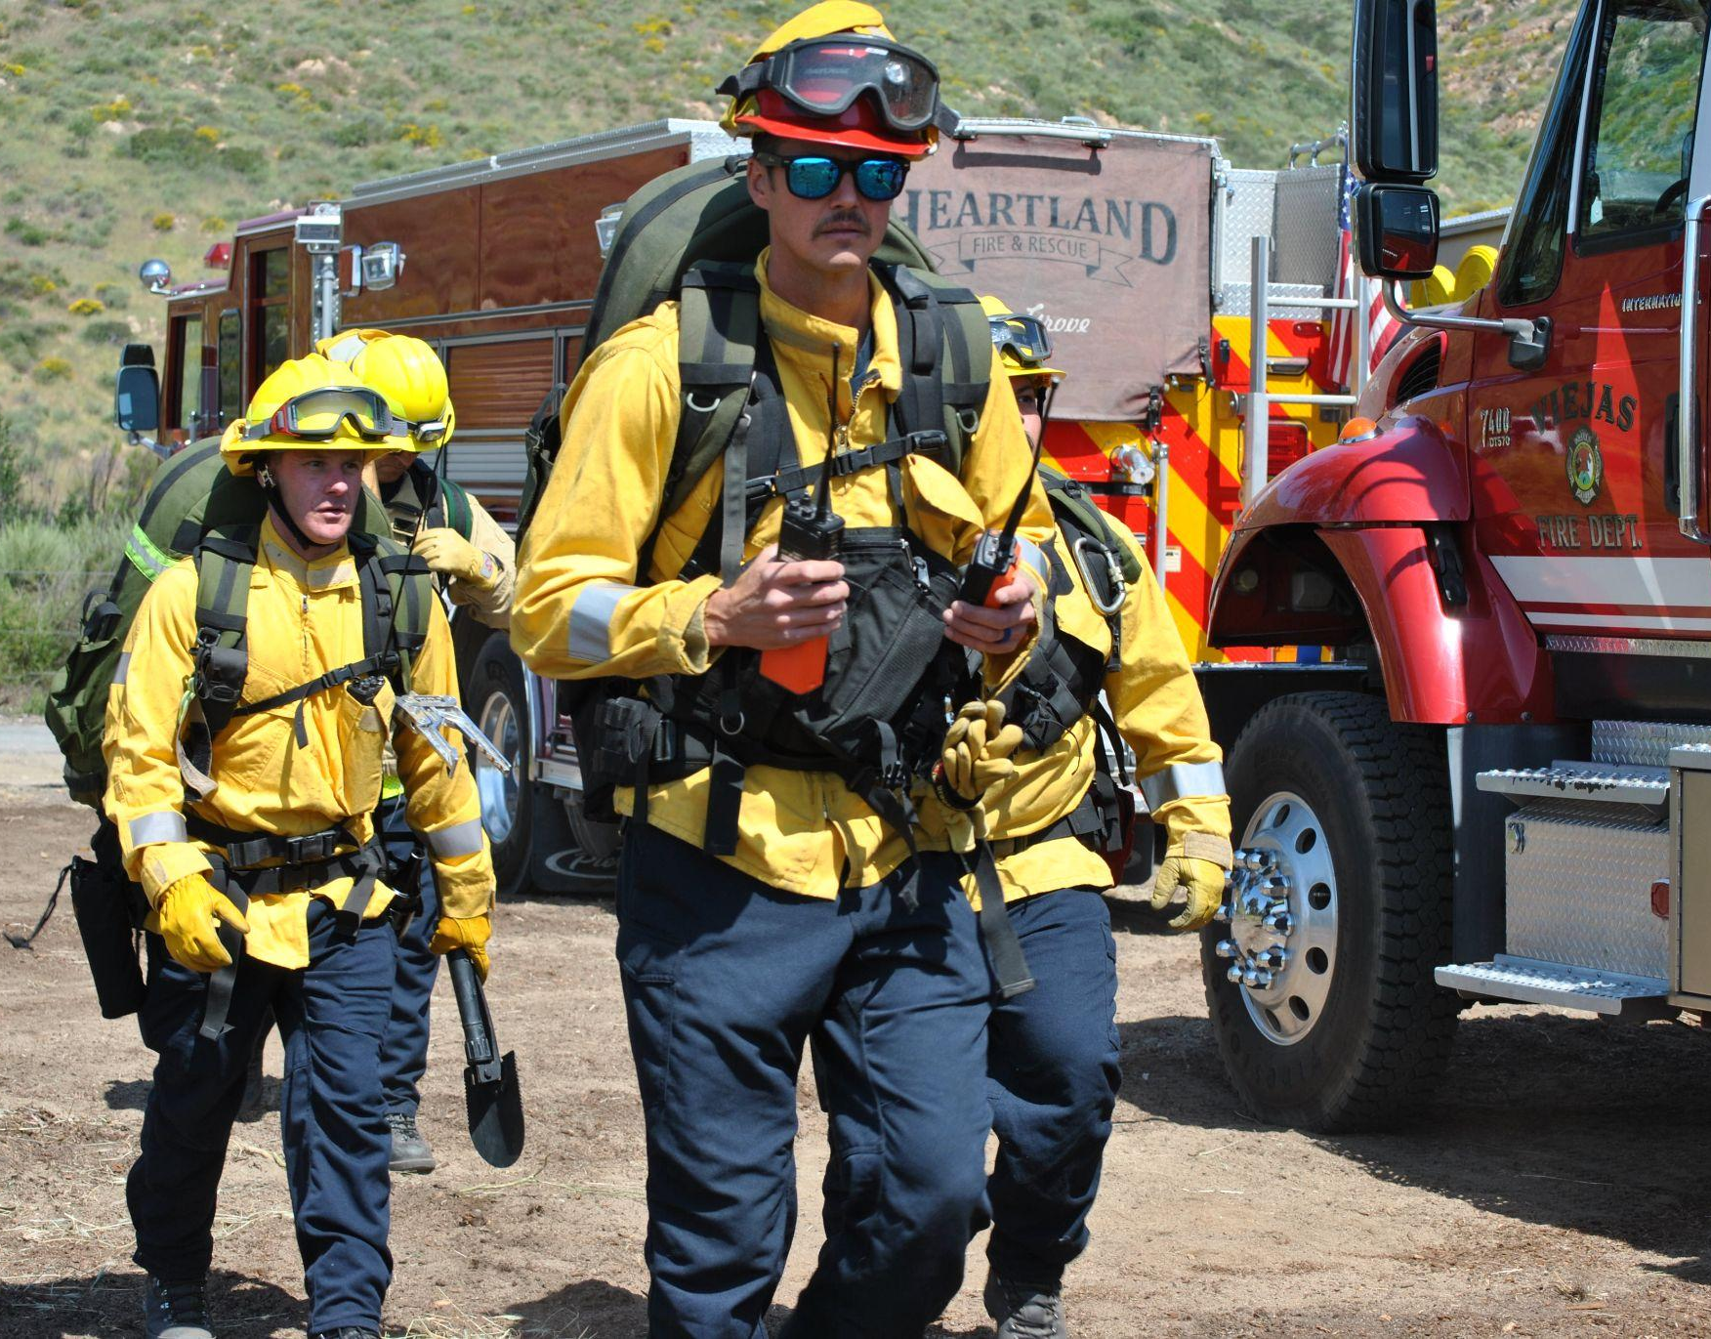
Local Control and Fiscal Accountability
A clear system of accountability, including citizen oversight, independent audits and public disclosure of how all funds are spent.
Every dime raised by the measure will be reinvested back into Lemon Grove to fund essential services.
By law, the money can’t be taken away by the State or County.

Slide 6
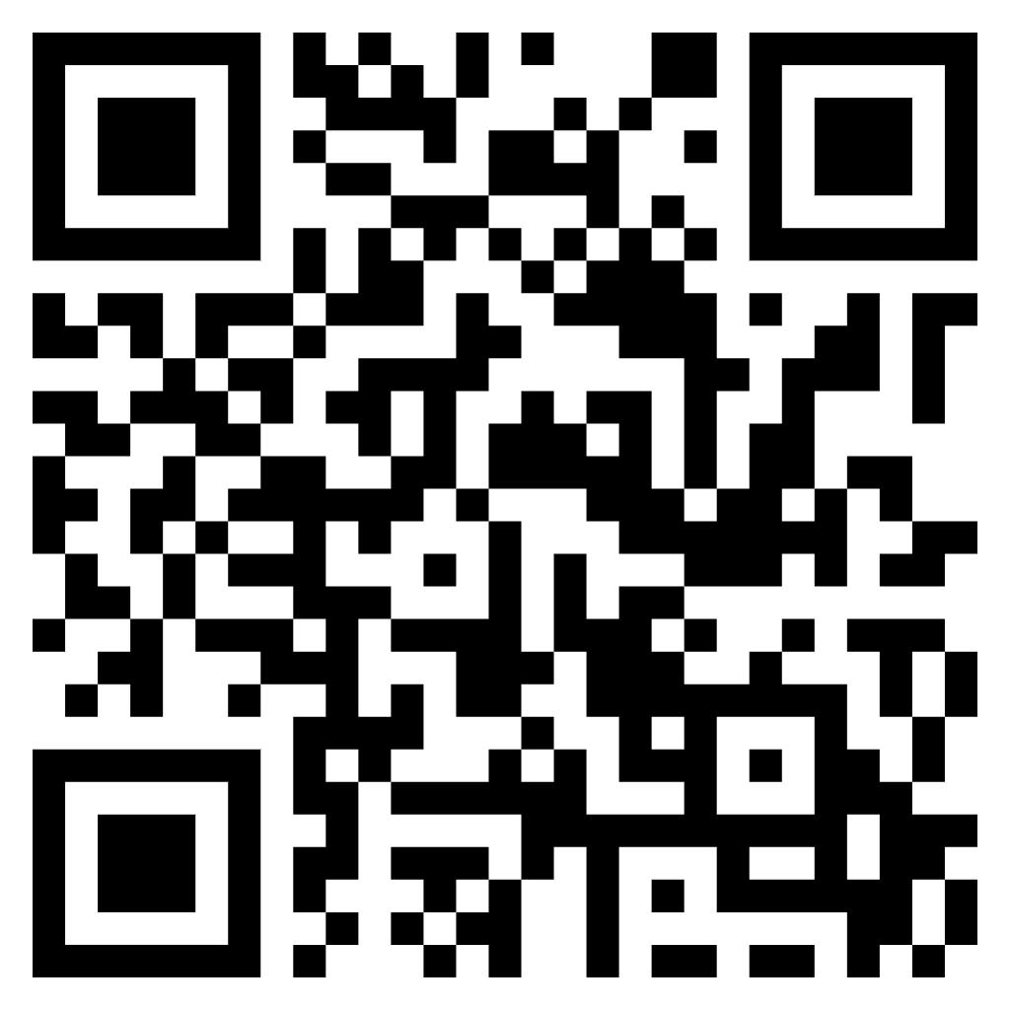
Learn More!
We welcome your feedback and questions. For more information on the ballot measure, please scan the QR code on the right or visit tinyurl.com/LemonGroveNov2024Measure

