Slide 1
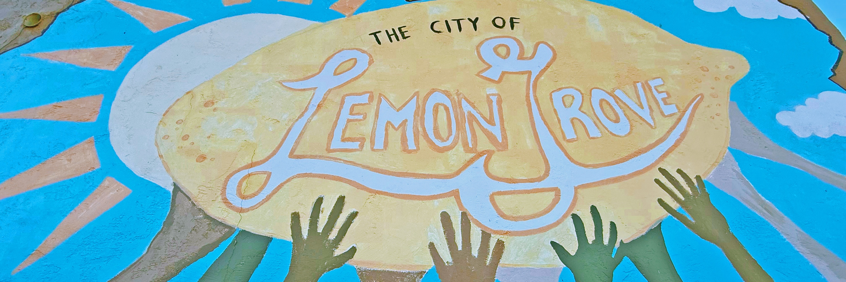


Workshop #2 | September 9, 2026

Slide 2
Project Team
City of Lemon Grove
Tony Winney
City Manager
Michael Fellows
Community Development Manager
Bill Chopyk
Special Projects Administrator
RICK
Brooke Peterson
Principal in Charge
Sydney Rankmore
Project Manager
Juan Alberto Bonilla
Urban Designer

Slide 3
Workshop 2 - Purpose
Share the Draft Downtown Specific Plan
Demonstrate how community input shaped the Draft Plan
Highlight proposed changes
Gather feedback to finalize the Plan
Notes:
Community input: workshop 1, feedback shared at the PC-CC workshop, community survey and other touchpoints such as our meeting with Revitalize Broadway.
I am going to walk through a high level summary of the proposed changes in the 2026 Draft to the current SP and then we will have extensive time during the open house portion to go into detail and further discussion on anything that is of particular interest/importance to you.

Slide 4
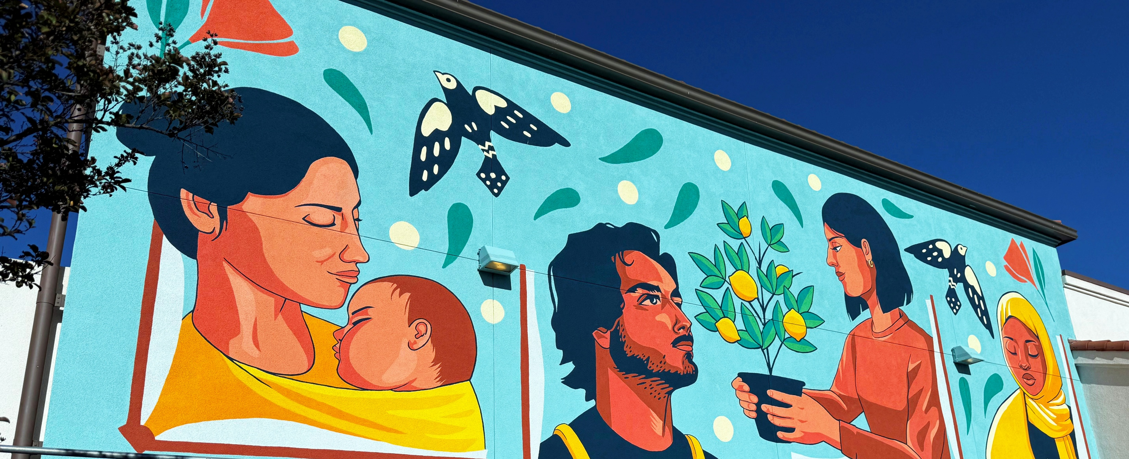
Quick Refresh

Slide 5
What is a Specific Plan?
Provides the vision for how a particular area will grow and change over time
A Specific Plan regulates things like:
    What gets built (housing, shops, parks, etc.)
    How big or dense it can be (building heights, number of units)
    What it looks like (design standards, streetscape, architecture)
    How people get around (roads, bike lanes, sidewalks, transit)
    What infrastructure is needed (drainage, utilities, public spaces)
    How and when it gets built (phasing, financing, implementation)
Notes:
Specific plans are planning document that guide how a specific area, like Downtown Lemon Grove, will grow and change over time.
It can define what types of development are appropriate, such as housing, shops, parks, or mixed-use projects.
It can also establish standards for how that development occurs such as including building heights, density, and overall scale.
The Plan also looks at the elements of community character and design, including architecture, streetscape improvements, landscaping, and the overall look and feel of downtown.
Another major component is mobility, or how people move through the area, whether by walking, biking, driving, or transit.
Specific Plans also identify infrastructure and public improvements needed to support future growth, such as utilities, drainage, and public spaces.
Finally, the Plan helps outline how improvements and development could be implemented over time, including priorities, phasing, and potential funding approaches.

Slide 6
What is NOT included in the Specific Plan?
The Downtown Specific Plan does not:
    Authorize the City to use eminent domain to obtain private property
    Require existing businesses to close or change their business
Notes:
We also want to be clear as to what the Specific Plan does not do/does not allow for:
Eminent domain. A specific plan does not provide the City with eminent domain authority. There are other processes and steps legally required before a City can exercise eminent domain and it is not the intent of the City to invoke those steps through this process.
The specific plan does not require or dictate any actions. The Plan is a framework for future development and investment and is subject to property owner decisions and actions.

Slide 7

Project Schedule

Slide 8
Why is the City Updating the Plan?
The current plan was adopted more than 20 years ago. The update will help Lemon Grove:
Support businesses and investment
Improve streets and public spaces
Plan for housing and growth
Guide future improvements and funding
Maintain local control over development in downtown
Continues to protect local historic resources
Provides framework for change over time- not overnight
A clear vision for Downtown’s future.
Notes:
Communities change over time, and planning documents should evolve with them.
The current Downtown Specific Plan was adopted more than 20 years ago. Since then, Lemon Grove has experienced new housing needs, changing economic conditions, increased investment in transit, and new State laws that affect how cities plan for growth.
Updating the plan allows the City to:
Create a clear vision for downtown's future –a clear and therefore effective path forward for the future of the City
Encourage investment and revitalization
Improve walkability and safety
Support local businesses
Plan for housing near transit
Enhance parks, plazas, and public gathering spaces
Coordinate future infrastructure improvements
Position the City to compete for state and federal grants
Rather than allowing growth to occur project by project, the Specific Plan helps ensure that future development follows a community-supported vision.

Slide 9
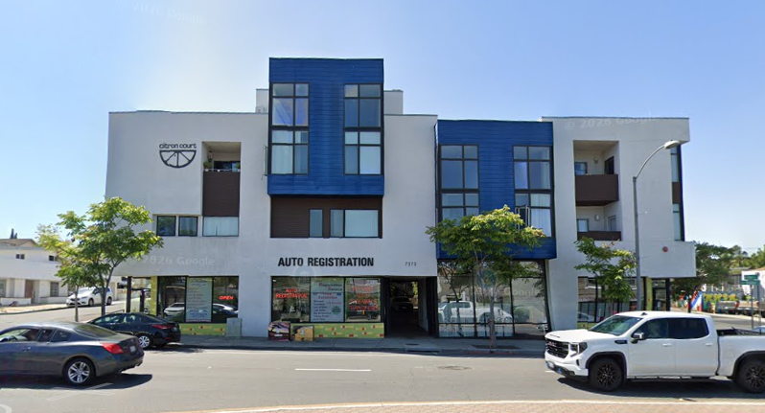
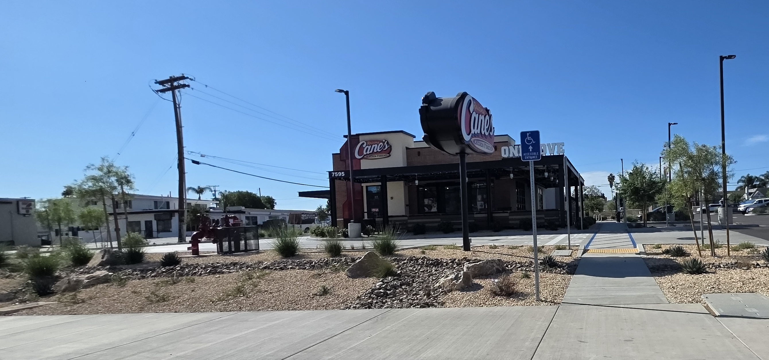
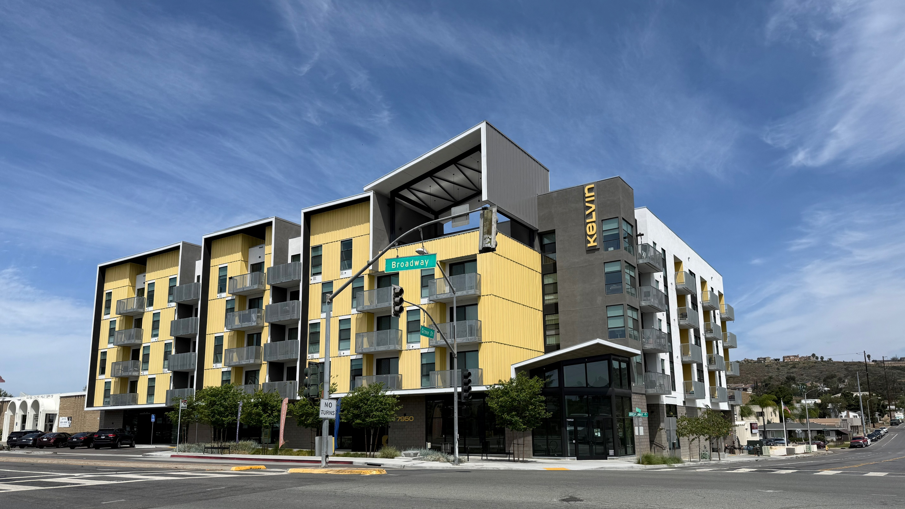
Downtown Today
Notes:
Speak to existing form and character

Slide 10
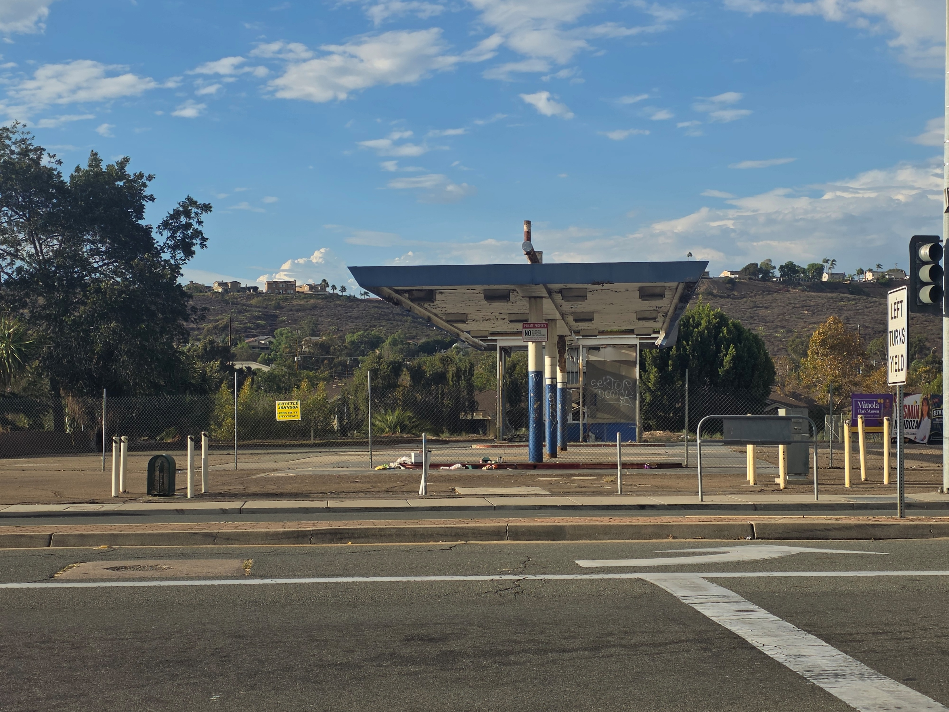
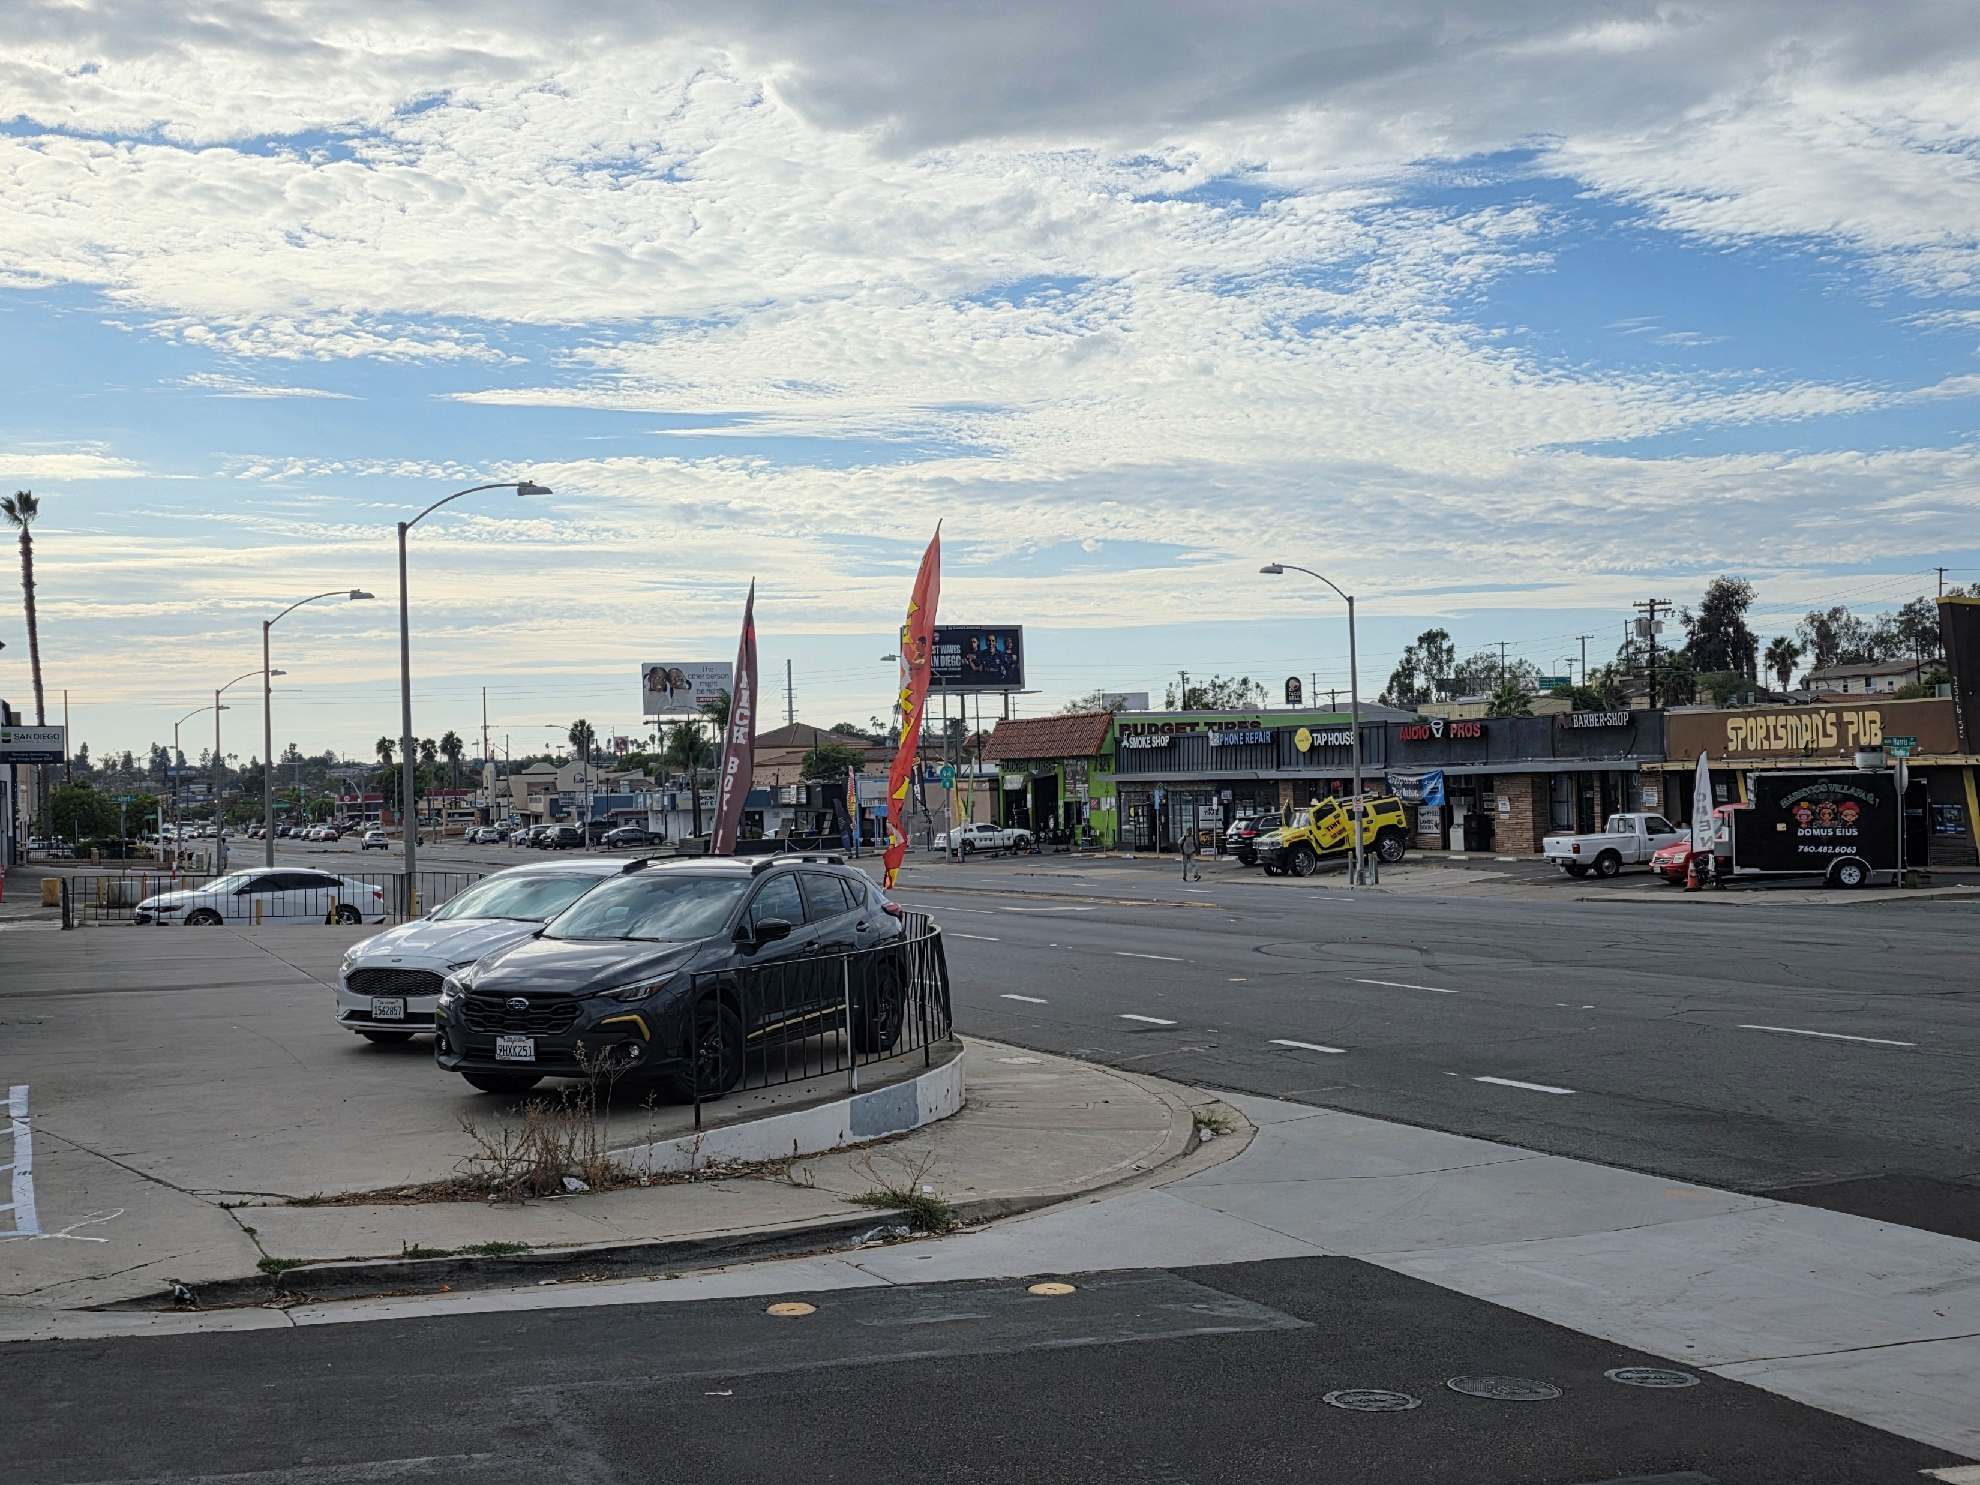
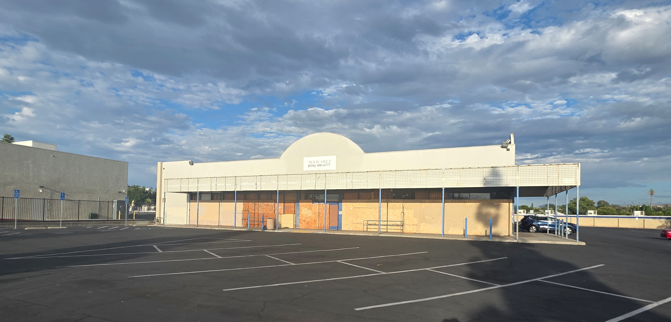
Also Downtown Today
Notes:
Speak to opportunities to address mismatched adjacent, vacant storefronts and poorly maintained businesses – be sensitive here

Slide 11
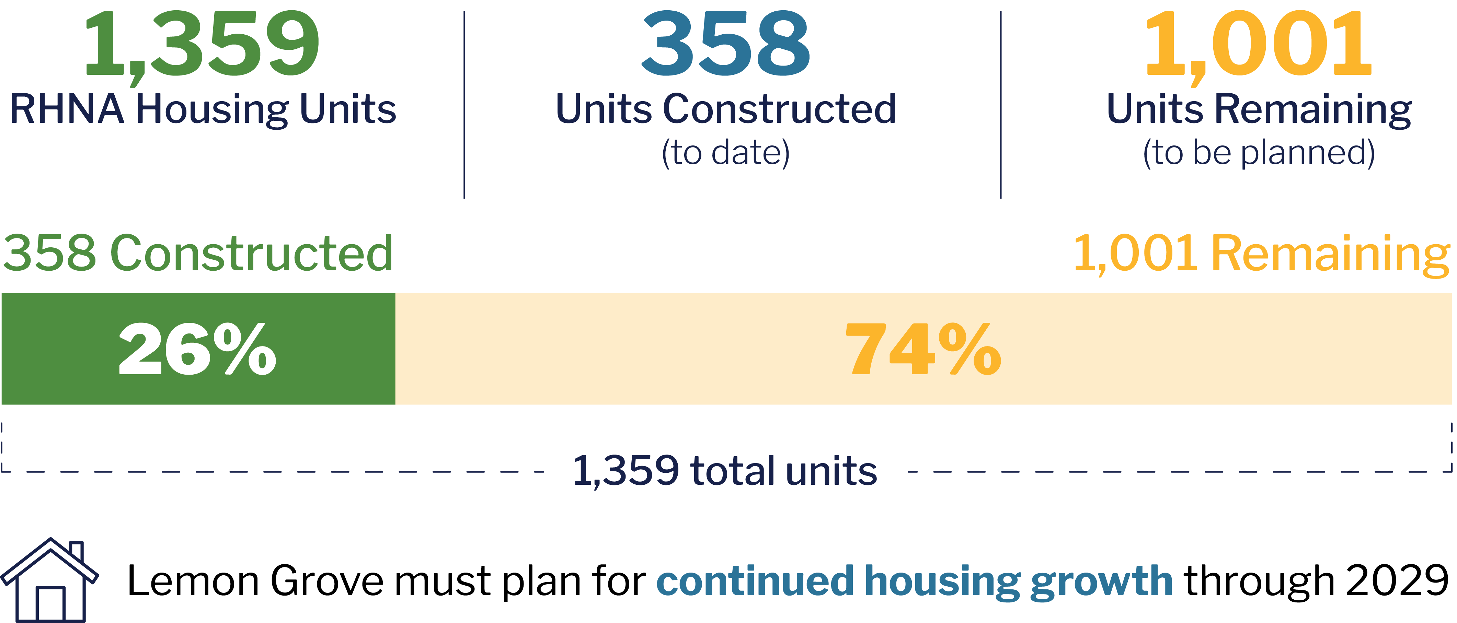
Lemon Grove’s Housing Need
6th RHNA Cycle: April 30, 2021 – April 30, 2029
Notes:
As already shared, the SP creates a vision for downtown's future and an important component of that is residential growth.
The City’s adopted Housing Element in its General Plan already identifies the city’s obligation to the number of housing units to be built between 2021-2029. The Housing Need is determined for each region by HCD, then for each City by SANDAG (spell out).
The City’s Housing Need is 1,359 units, there have been 26% of those units built which demonstrates the need to plan for additional housing. The draft SP plans for that growth and directs that in the downtown of the City around existing transportation infrastructure, rather than push that growth into the residential neighborhoods which would otherwise impact the fabric of those neighborhoods. An important note is that these units are closely monitored by HCD. Fulfilling the City’s RHNA housing requirements is a fundamental, mandatory requirement and there are true, actual repercussions for the City, if they don’t meet the housing unit numbers.

Slide 12
How Will the Community Benefit?
A stronger Downtown will benefit the entire Lemon Grove community.
More Walkable: Safer, more comfortable streets
More Places to Go: Restaurants, shops, and services
More Housing Choices: Homes near transit and amenities
Better Public Spaces: Plazas, landscaping, and gathering places
Economic Growth: New businesses, jobs, and investment. Reduce vacant storefronts.
Smarter Growth: Make better use of existing infrastructure
Notes:
How Could the Community Benefit?
A successful downtown benefits everyone—even if you don't live downtown.
The updated Specific Plan is intended to create a downtown that is more vibrant, attractive, and economically successful while improving quality of life throughout Lemon Grove.
Potential community benefits include:
A More Walkable Downtown
Safer sidewalks, improved crossings, bicycle connections, landscaping, and public spaces can make downtown easier and more enjoyable to explore on foot.
More Restaurants, Shops and Services
Additional residents living downtown can help support the restaurants, cafés, neighborhood retail, and services that many residents have said they would like to see.
More Housing Choices
The plan encourages a variety of housing options near transit, helping young adults, working families, and seniors find homes that meet their needs while reducing pressure to build in established neighborhoods.
Better Public Spaces
Future improvements may include plazas, gathering spaces, public art, landscaping, outdoor dining, and streetscape enhancements that create places where people can meet, relax, and enjoy community events.
Economic Growth
New investment can increase property values, attract businesses, create jobs, and generate additional local revenue to help fund City services and infrastructure improvements.
Smarter Growth
Focusing growth near existing roads, utilities, and the San Diego Trolley helps make more efficient use of public infrastructure while supporting regional sustainability goals.

Slide 13
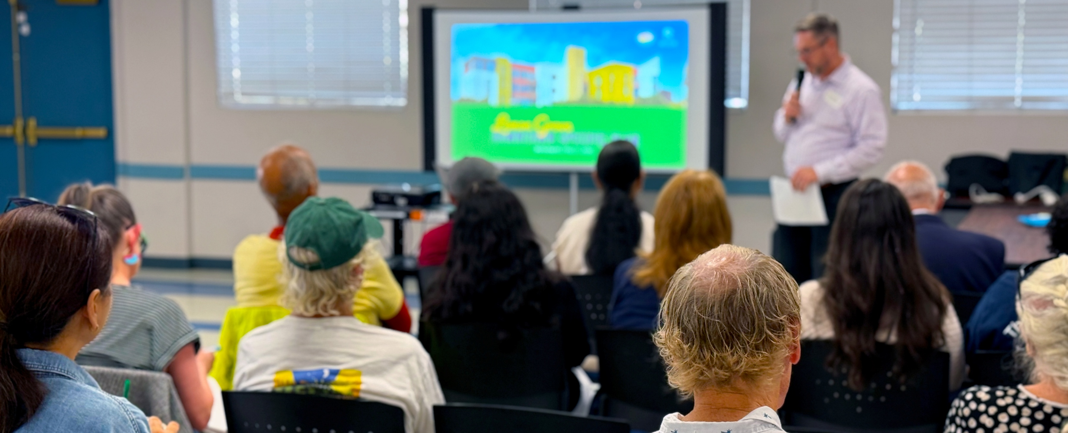
What We’ve Heard So Far

Slide 14

How We’ve Engaged the Community

Slide 15

What We Heard: Key Themes
Notes:
We’ve heard how great the desire is to provide more destination opportunities – restaurants, retail/shops, entertainment – as well as gathering spaces such as outdoor dining, plazas and gathering spaces and things to do – such as events, markets such as beyond your farmers market, and similar.
We’ve heard the desire for elements that improve the aesthetics and atmosphere and environment such as trees, shade, and lighting. Cleaner streets and maintained properties were also elements important to you as the community that will improve the experience.
Mobility safety through safer crossings and better sidewalks.
And we heard and recognize that it is really important for these changes and improvements to happen while still holding onto and preserving LG’s small-town feel.

Slide 16
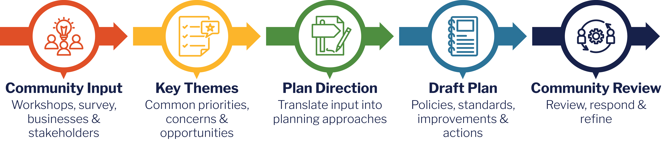
From Community Input to Draft Plan

Slide 17
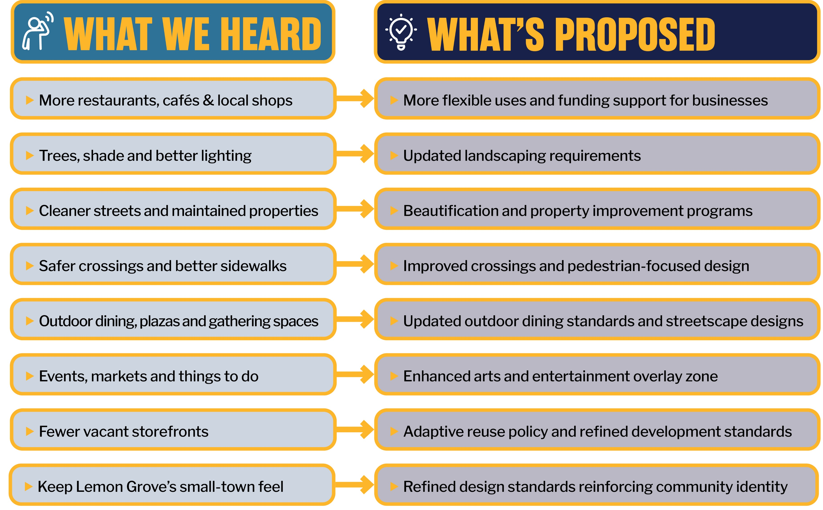
How We’ve Incorporated Your Input
Notes:
More restaurants, cafés & local shops → More flexible uses and funding support for businesses
Trees, shade & better lighting → Updated landscaping requirements
Cleaner streets & maintained properties → Beautification and property improvement programs
Safer crossings & better sidewalks → Improved crossings and pedestrian-focused design
Outdoor dining, plazas & gathering spaces → Updated outdoor dining standards and streetscape designs
Events, markets & things to do → Enhanced arts and entertainment overlay zone
Fewer vacant storefronts → Adaptive reuse policy and refined development standards
Keep Lemon Grove’s small-town feel → refined design standards reinforcing community identity

Slide 18
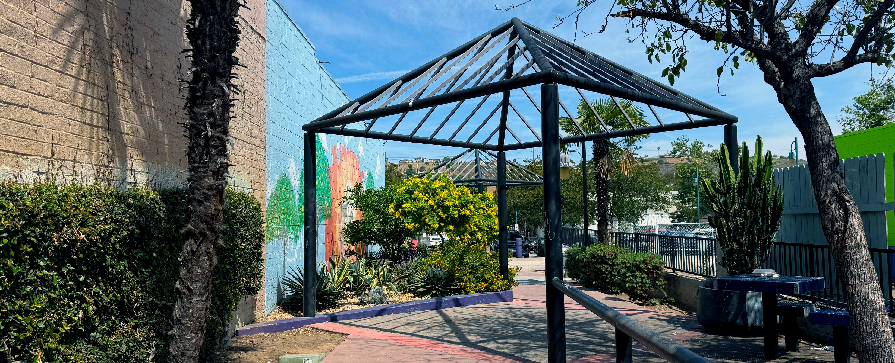
Draft Downtown Specific Plan

Slide 19
The 20 Year Vision for Downtown Lemon Grove
Imagine downtown Lemon Grove as a:
Vibrant, sustainable urban center
Mix of housing, shopping, entertainment & jobs
Green community with trees, parks & open spaces
Place for art, history & community life
Downtown with inviting public spaces
Maintain Lemon Groves' unique small-town character while activating and enhancing the downtown

Slide 20
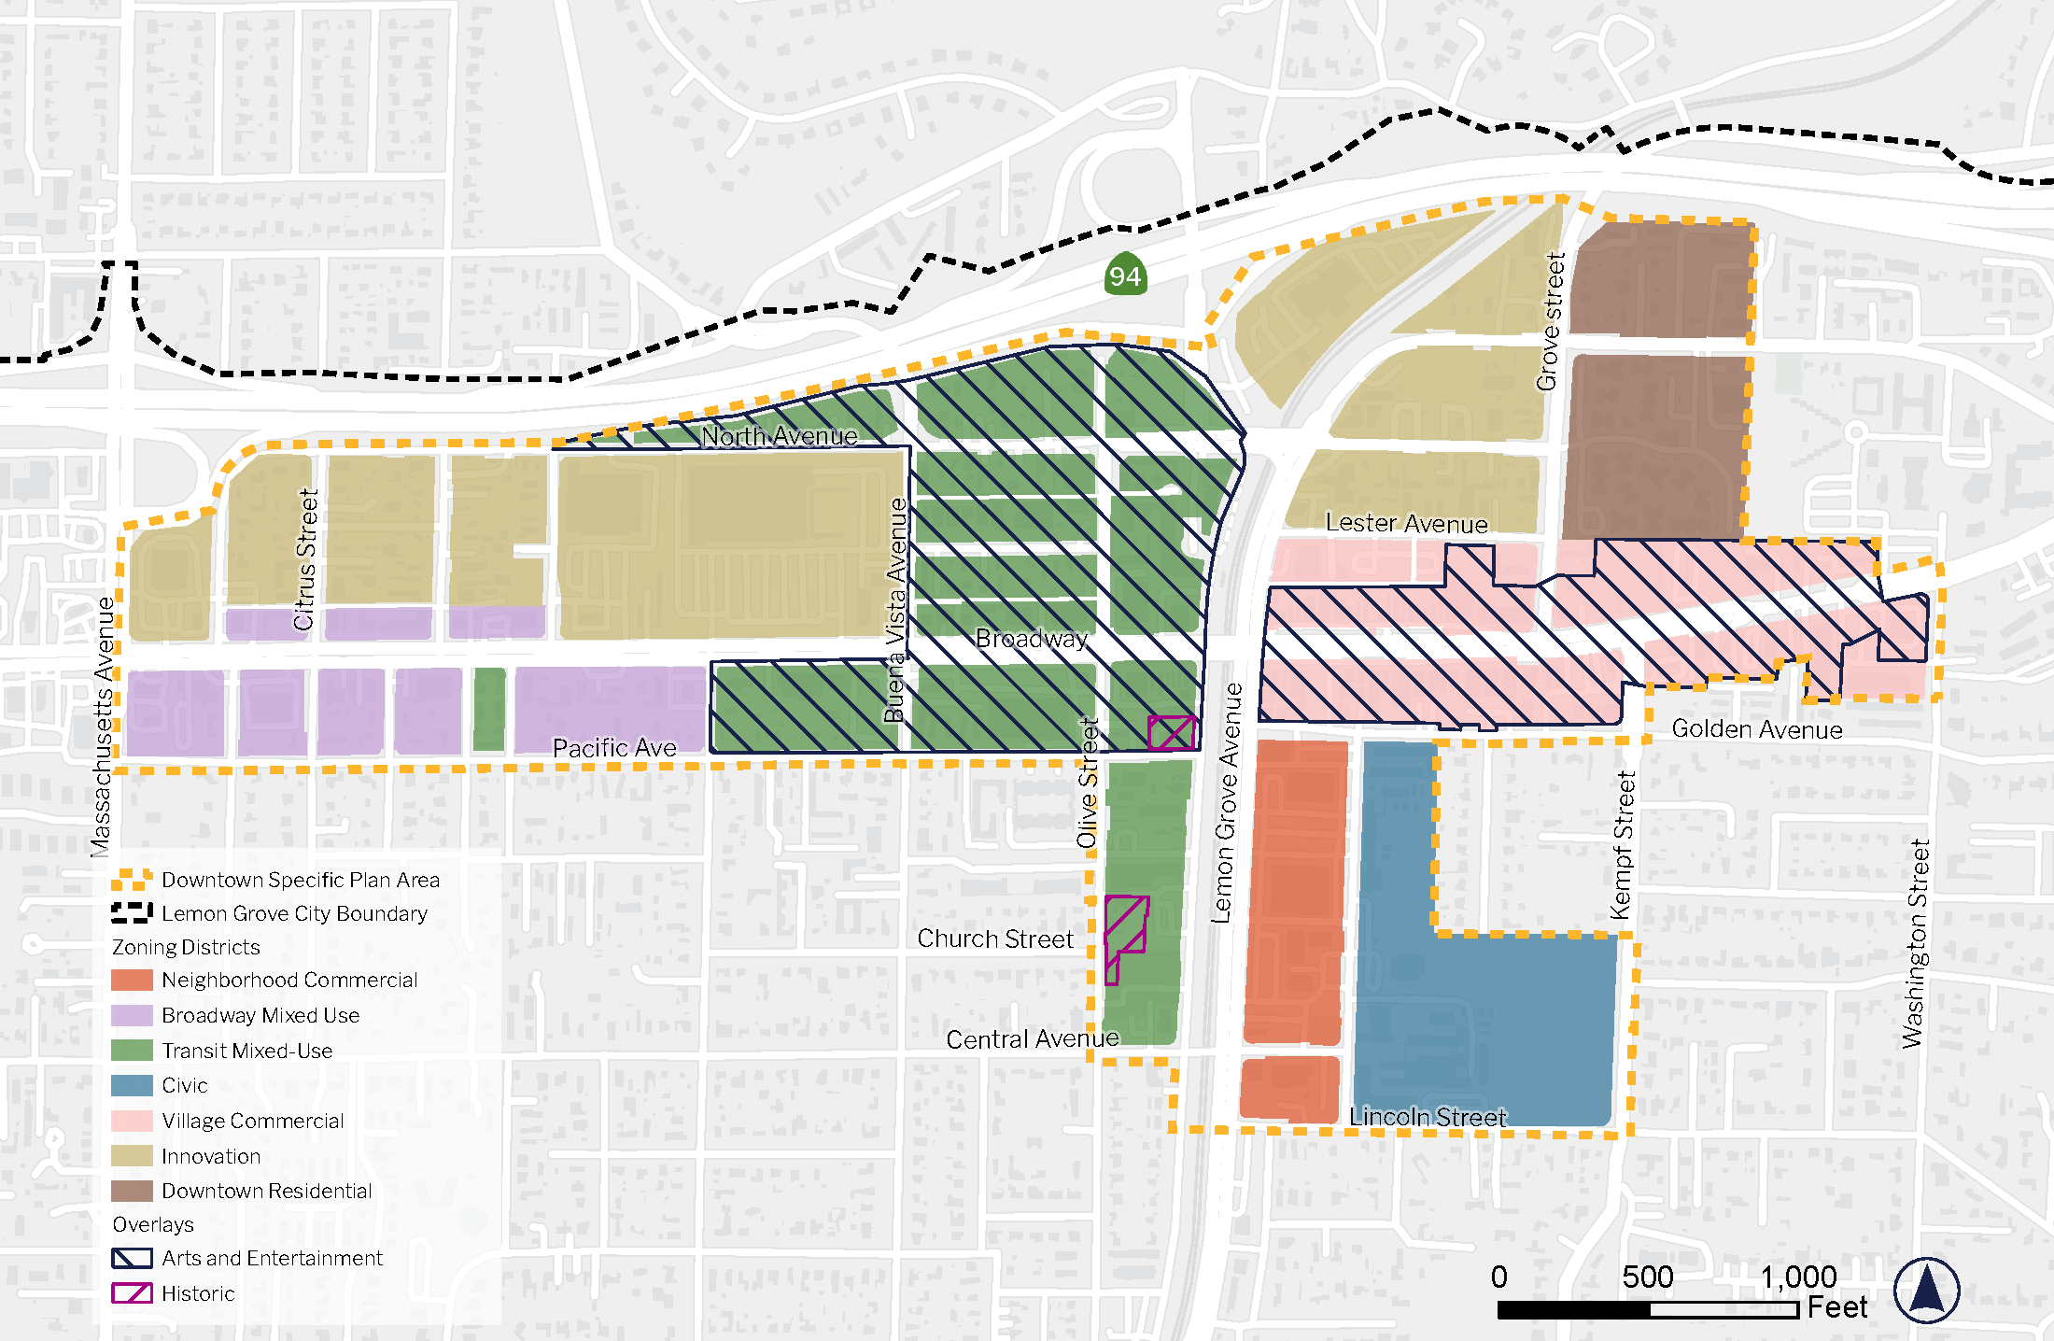
The Framework
Notes:
The Draft Plan gives different parts of Downtown clearer roles
Six downtown districts with tailored development standards:
Emphasis on mixed-use and residential development opportunities
Increased intensity focused near transit and key corridors
Pedestrian-oriented design and active street frontages
Reduced reliance on auto-oriented development patterns

Slide 21
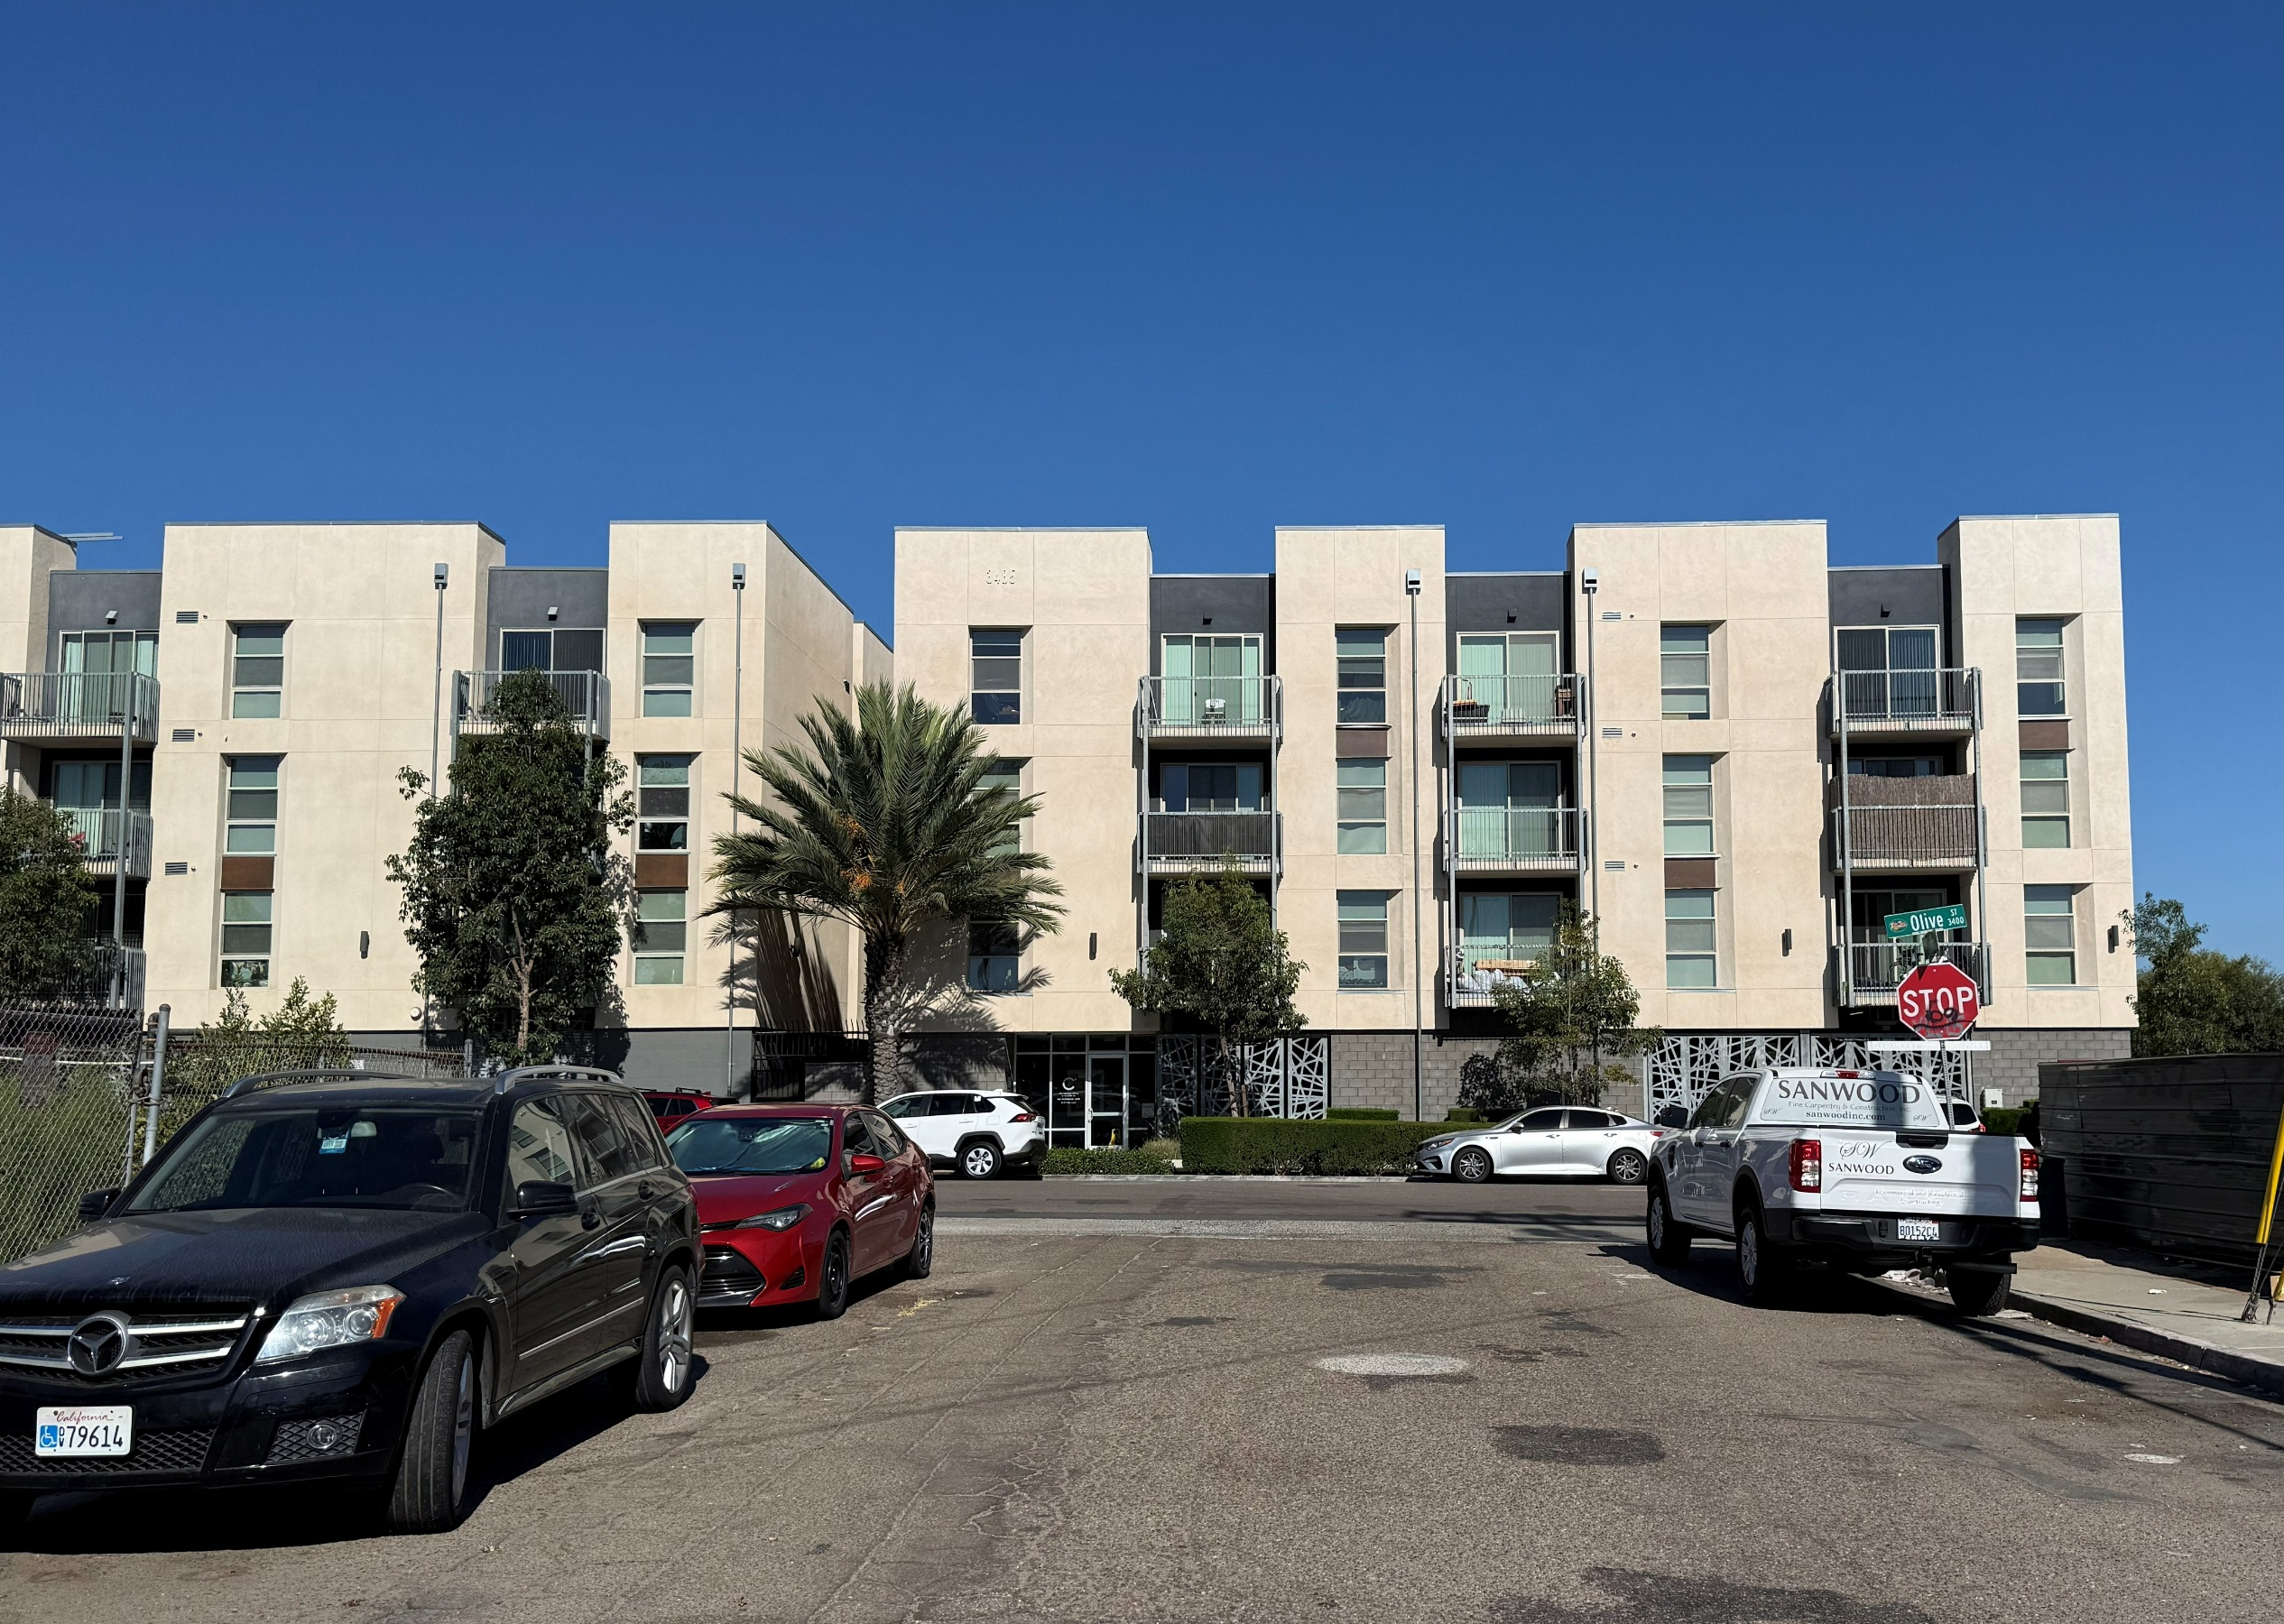
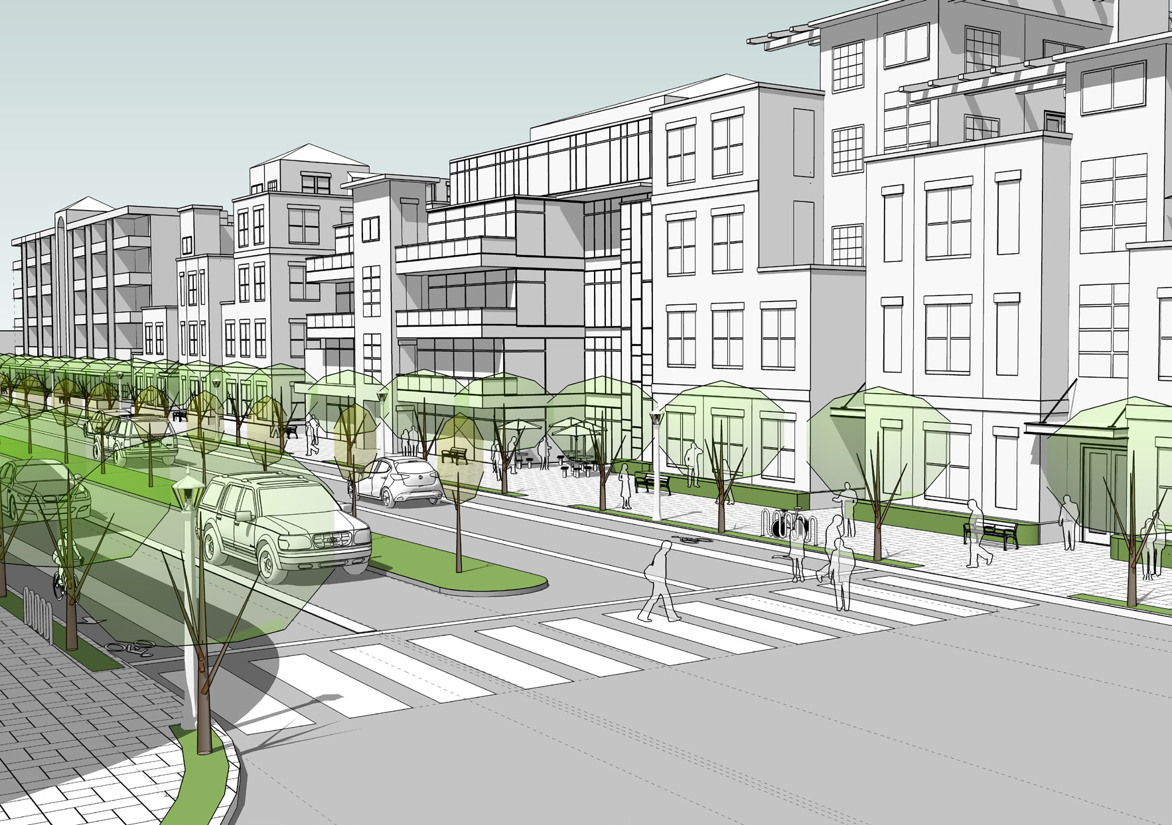
Transit Mixed-Use Zoning District
Maximum Height: 75 ft
Today
Proposed Next Chapter
Notes:
Centered around the Lemon Grove Depot.
Intended to support the greatest concentration of housing and activity Downtown.
Allows buildings up to 75 feet in certain areas
Creates opportunities for housing near transit, with commercial or community-serving uses on the ground floor.
Could also bring wider sidewalks, more trees, and better pedestrian connections

Slide 22
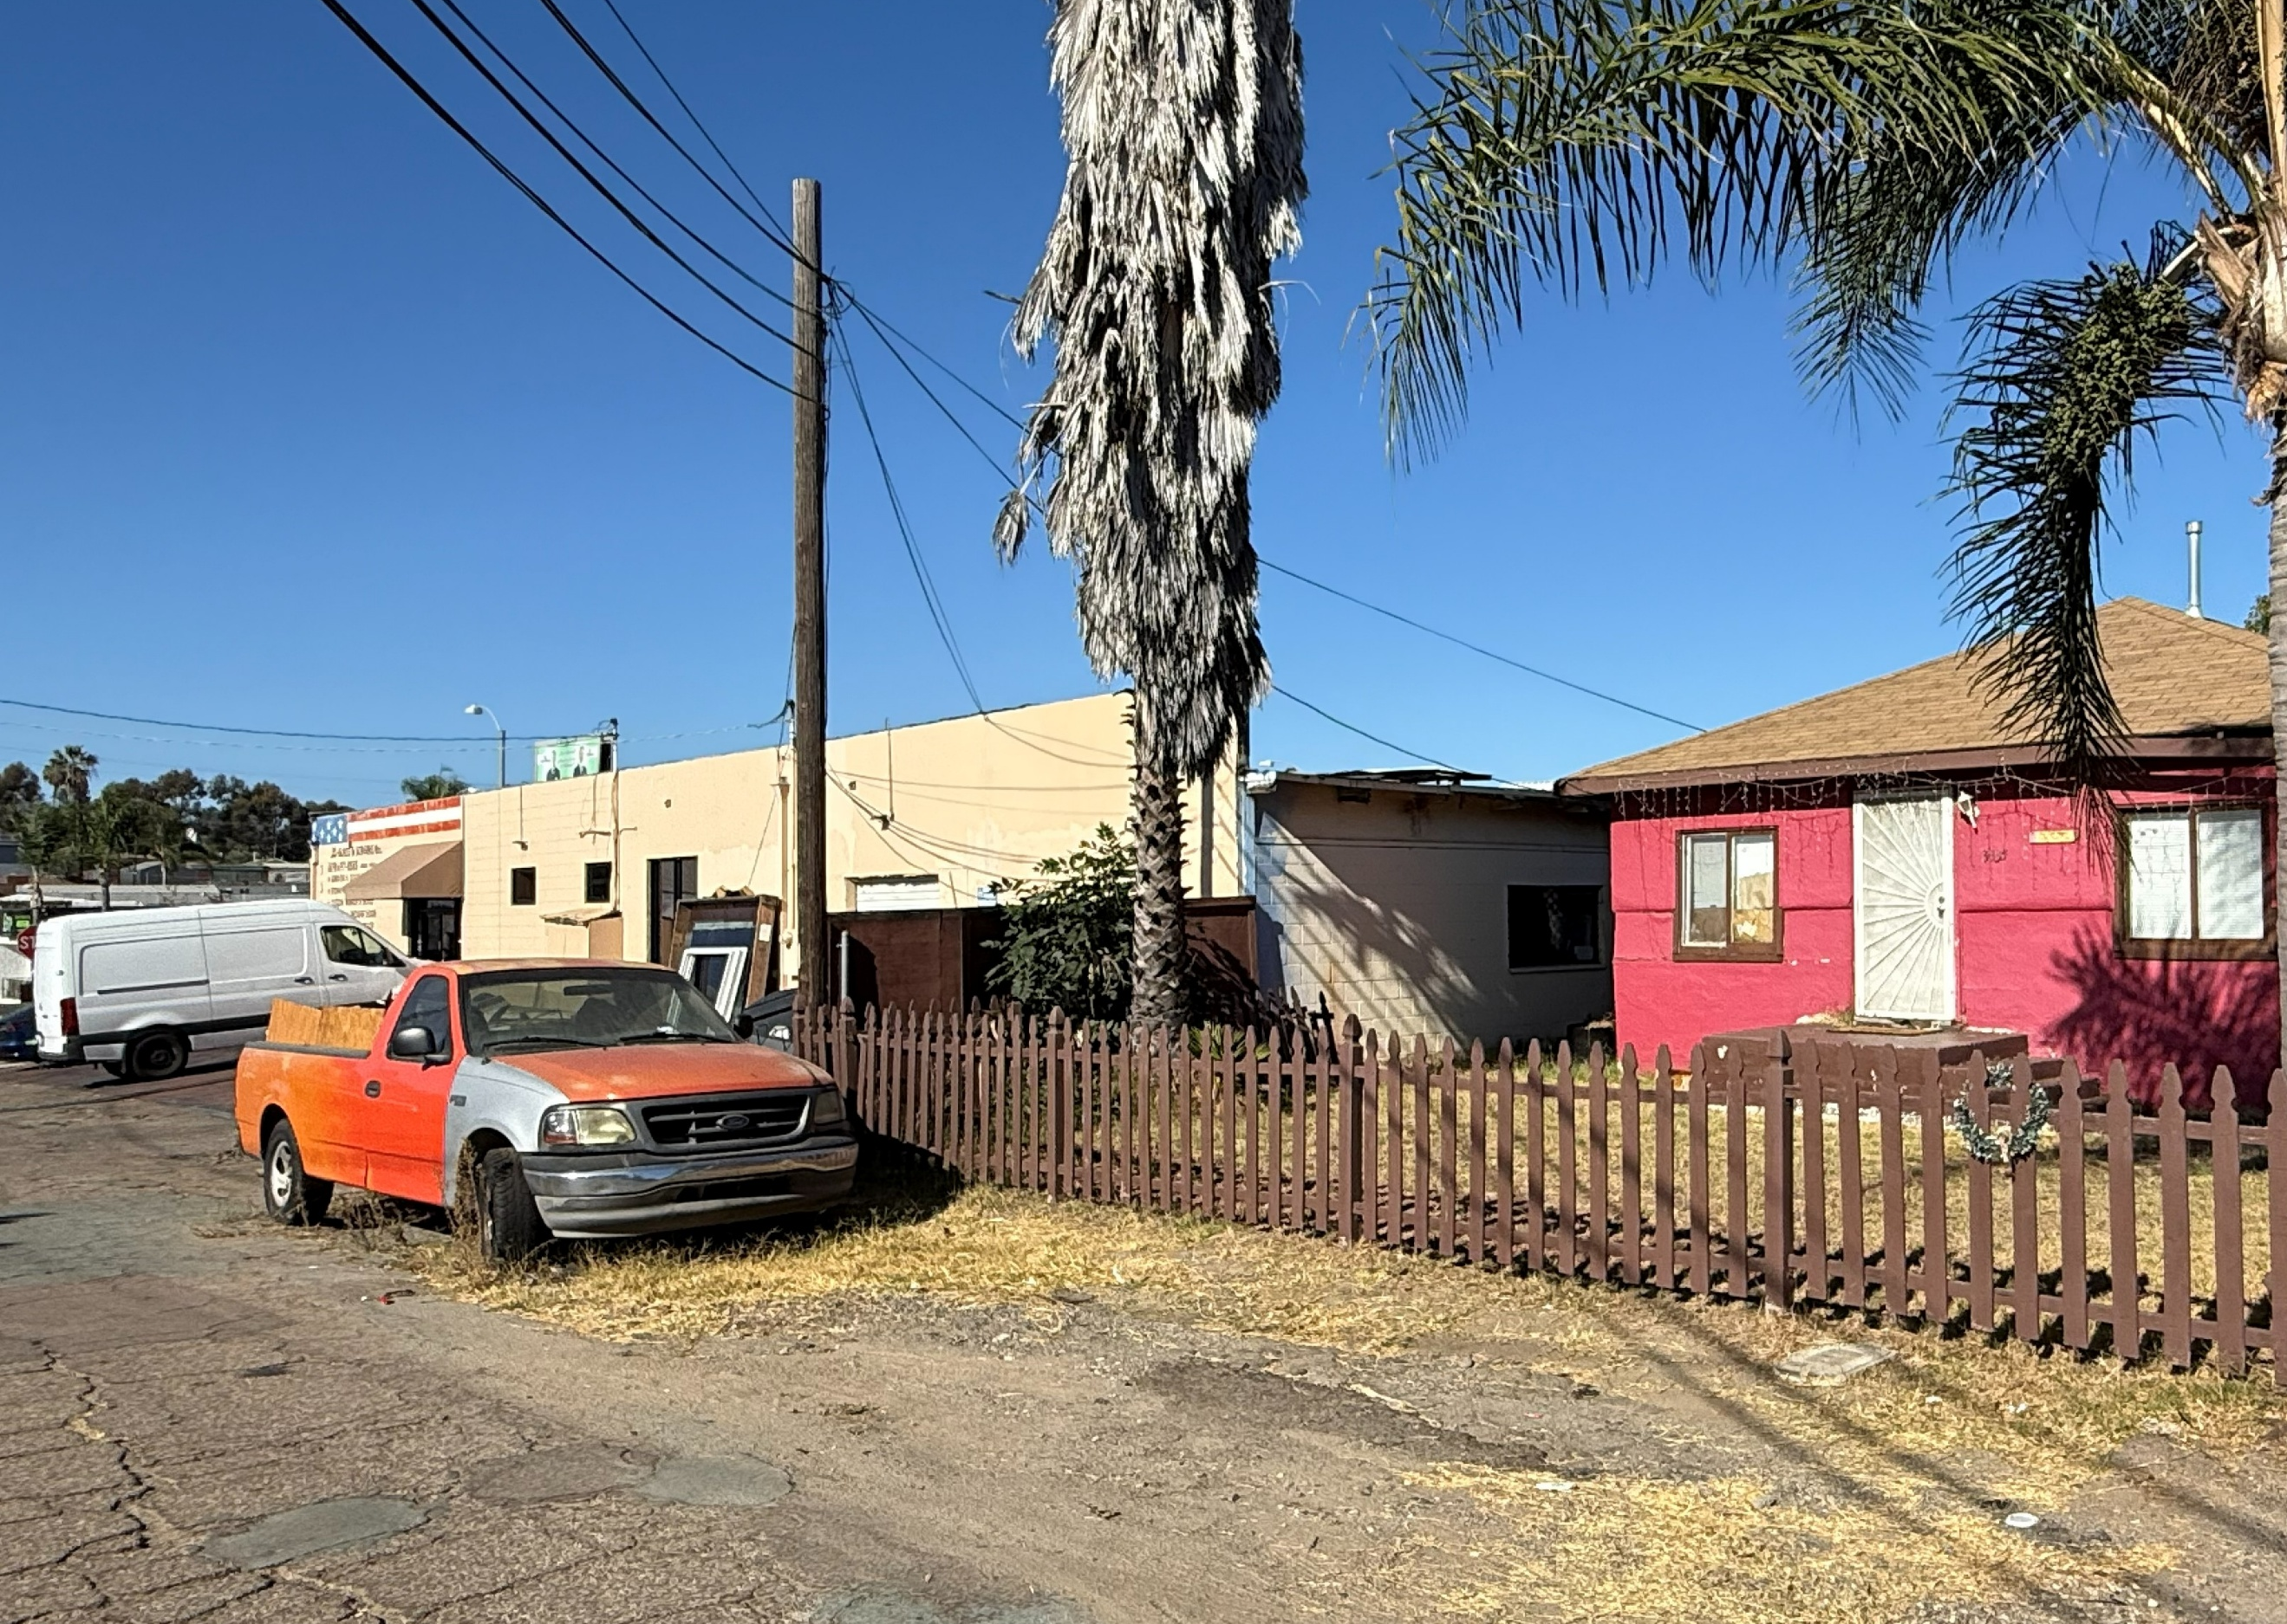
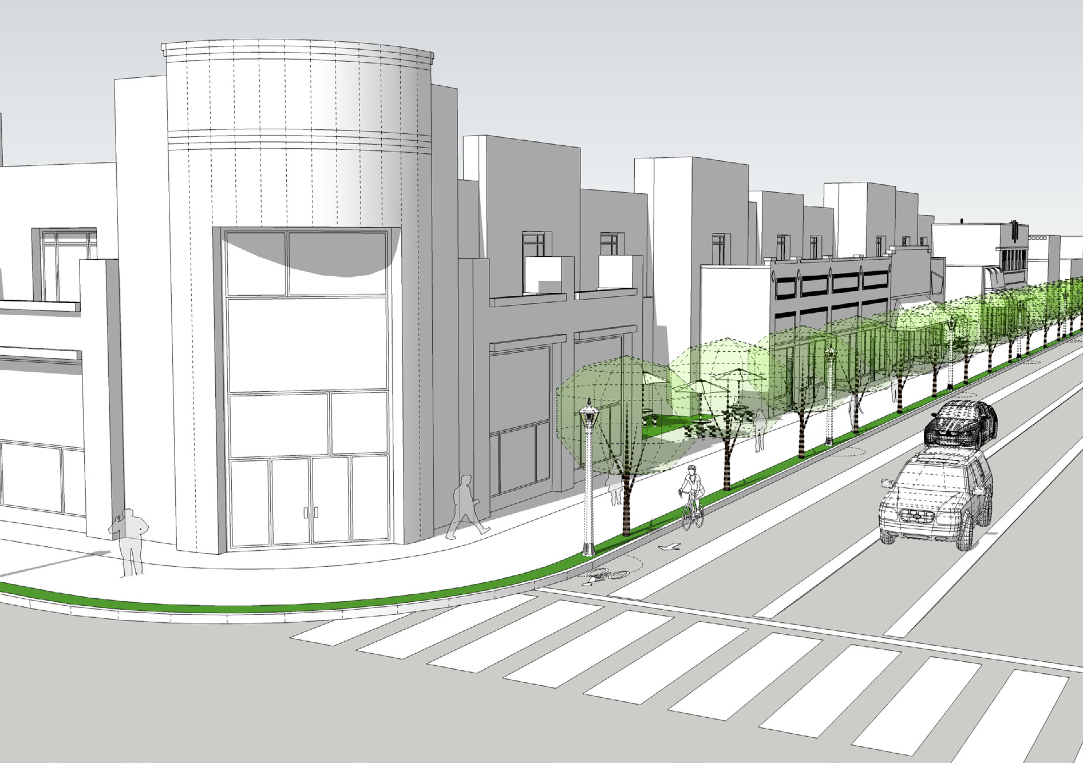
Broadway Mixed-Use Zoning District
Maximum Height: 45 ft
Today
Proposed Next Chapter
Notes:
Covers much of the western portion of Broadway and Pacific Avenue.
Supports a mix of housing and commercial uses.
The 45-foot height limit provides a transition to nearby neighborhoods.
Focuses on bringing buildings closer to the street and making Broadway more comfortable for people walking.
Change would happen gradually as individual properties redevelop.

Slide 23
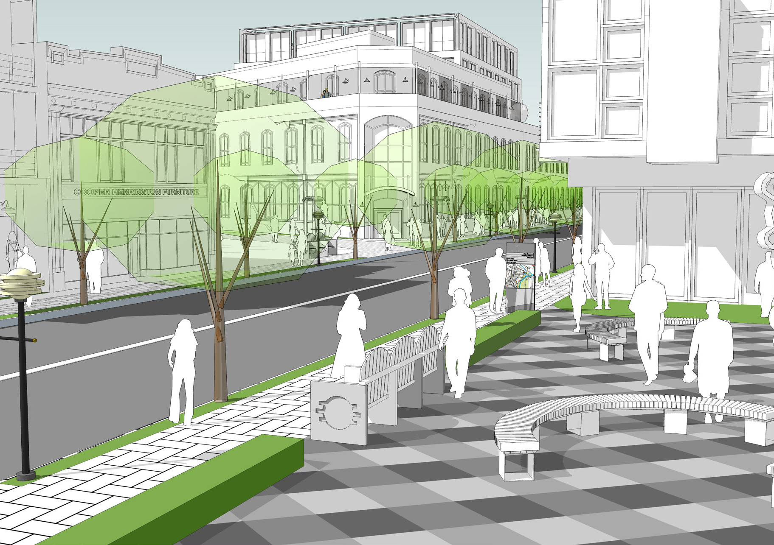
Innovation District
Maximum Height: 75 ft
Today
Proposed Next Chapter
Notes:
Intended to be one of the more flexible districts in the Plan.
Could accommodate businesses, jobs, housing, and creative or light industrial uses.
Recognizes the larger properties and different character of this area.
Allows buildings up to 75 feet in certain areas
Gives the area room to evolve while continuing to support businesses and employment.

Slide 24
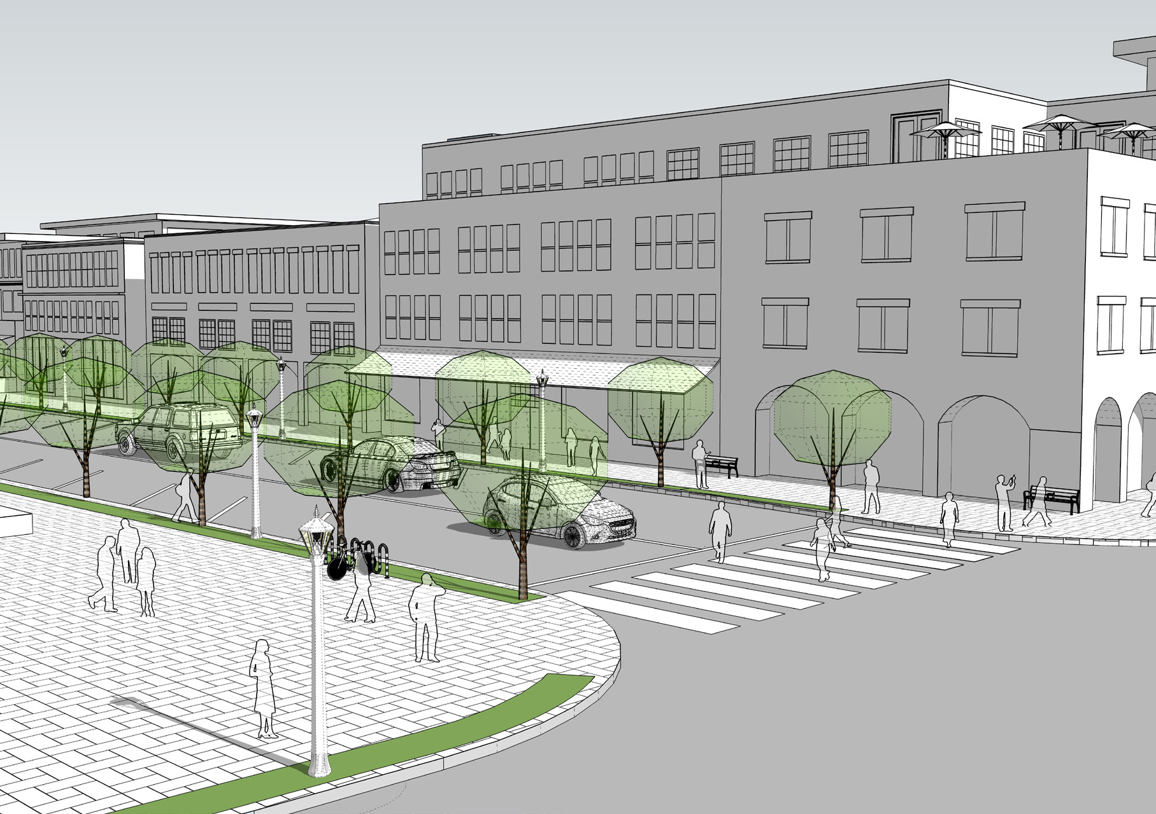
Village Commercial Zoning District
Maximum Height: 75 ft
Today
Proposed Next Chapter
Notes:
Covers the traditional commercial heart of Downtown, including areas around the Promenade.
Supports shops, restaurants, services, entertainment, housing, and community gathering spaces.
Allows buildings up to 75 feet in certain areas
Encourages activity on the ground floor and a more inviting pedestrian environment.
Intended to bring more people and activity into the center of Downtown.

Slide 25
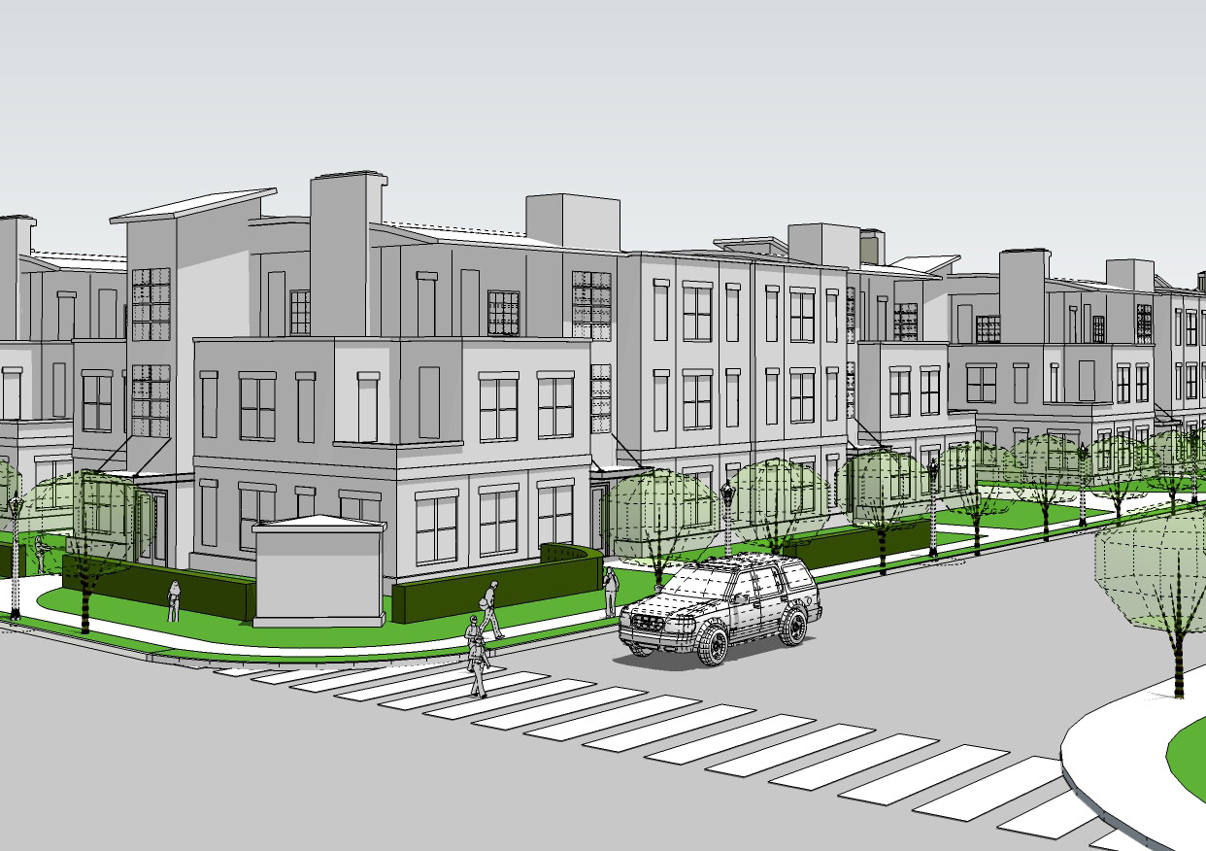
Downtown Residential Zoning District
Maximum Height: 55 ft
Today
Proposed Next Chapter
Notes:
Recognizes the existing residential character of this area while allowing more housing over time.
Could support different housing types, including townhomes and smaller apartment buildings.
Allows buildings up to 55 feet.
Includes standards to help new development fit with the surrounding neighborhood.
The illustration shows one example of what future residential development could look like.

Slide 26
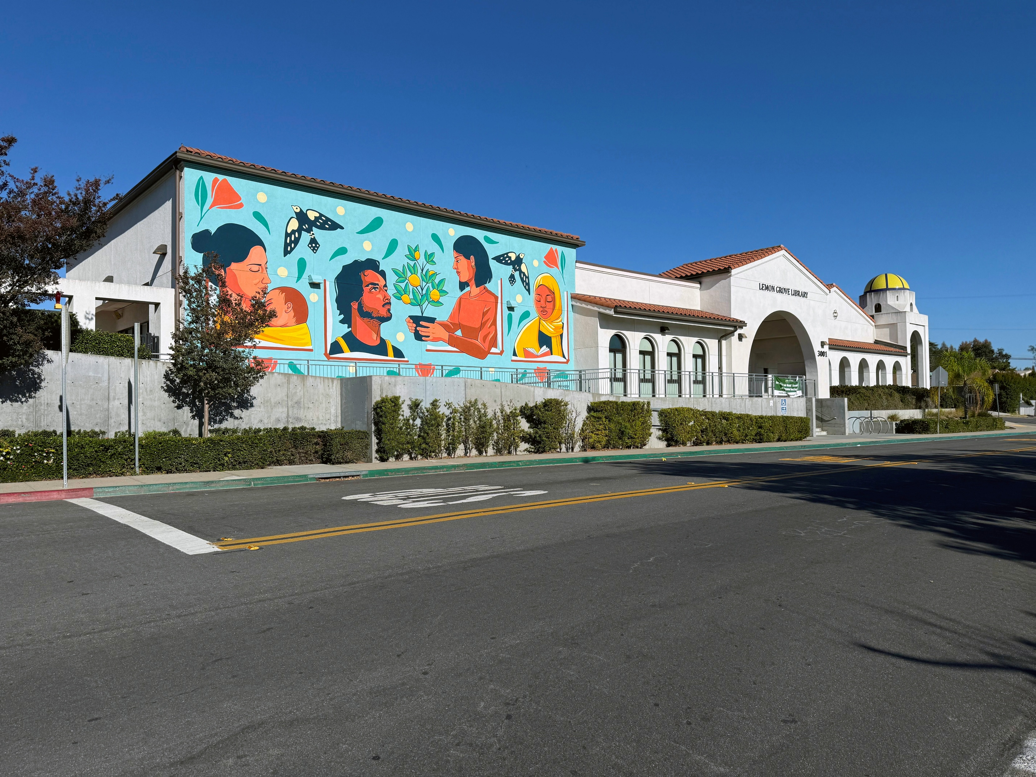
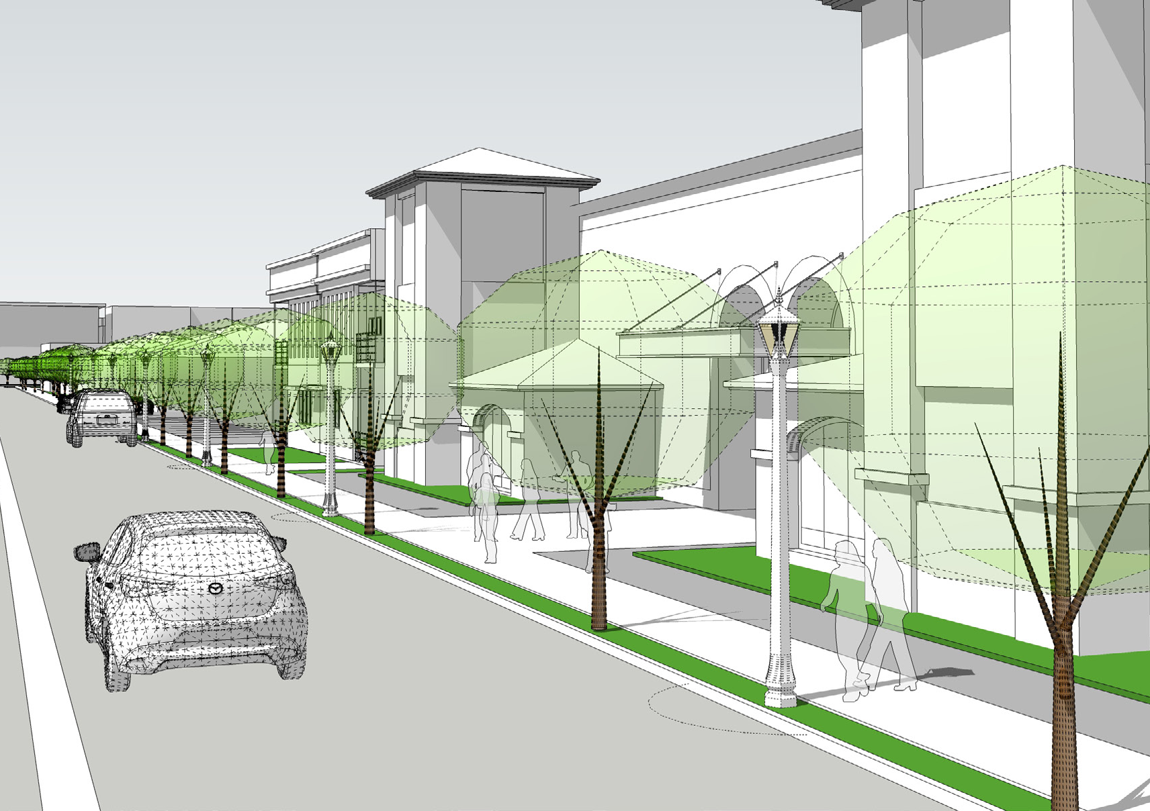
Civic Zoning District
Maximum Height: 45 ft
Today
Proposed Next Chapter
Notes:
Includes major public and community-serving properties.
Intended to maintain these important civic uses while allowing facilities to change as community needs evolve.
Allows buildings up to 45 feet.
Future improvements could create better pedestrian connections and a more welcoming street environment.

Slide 27
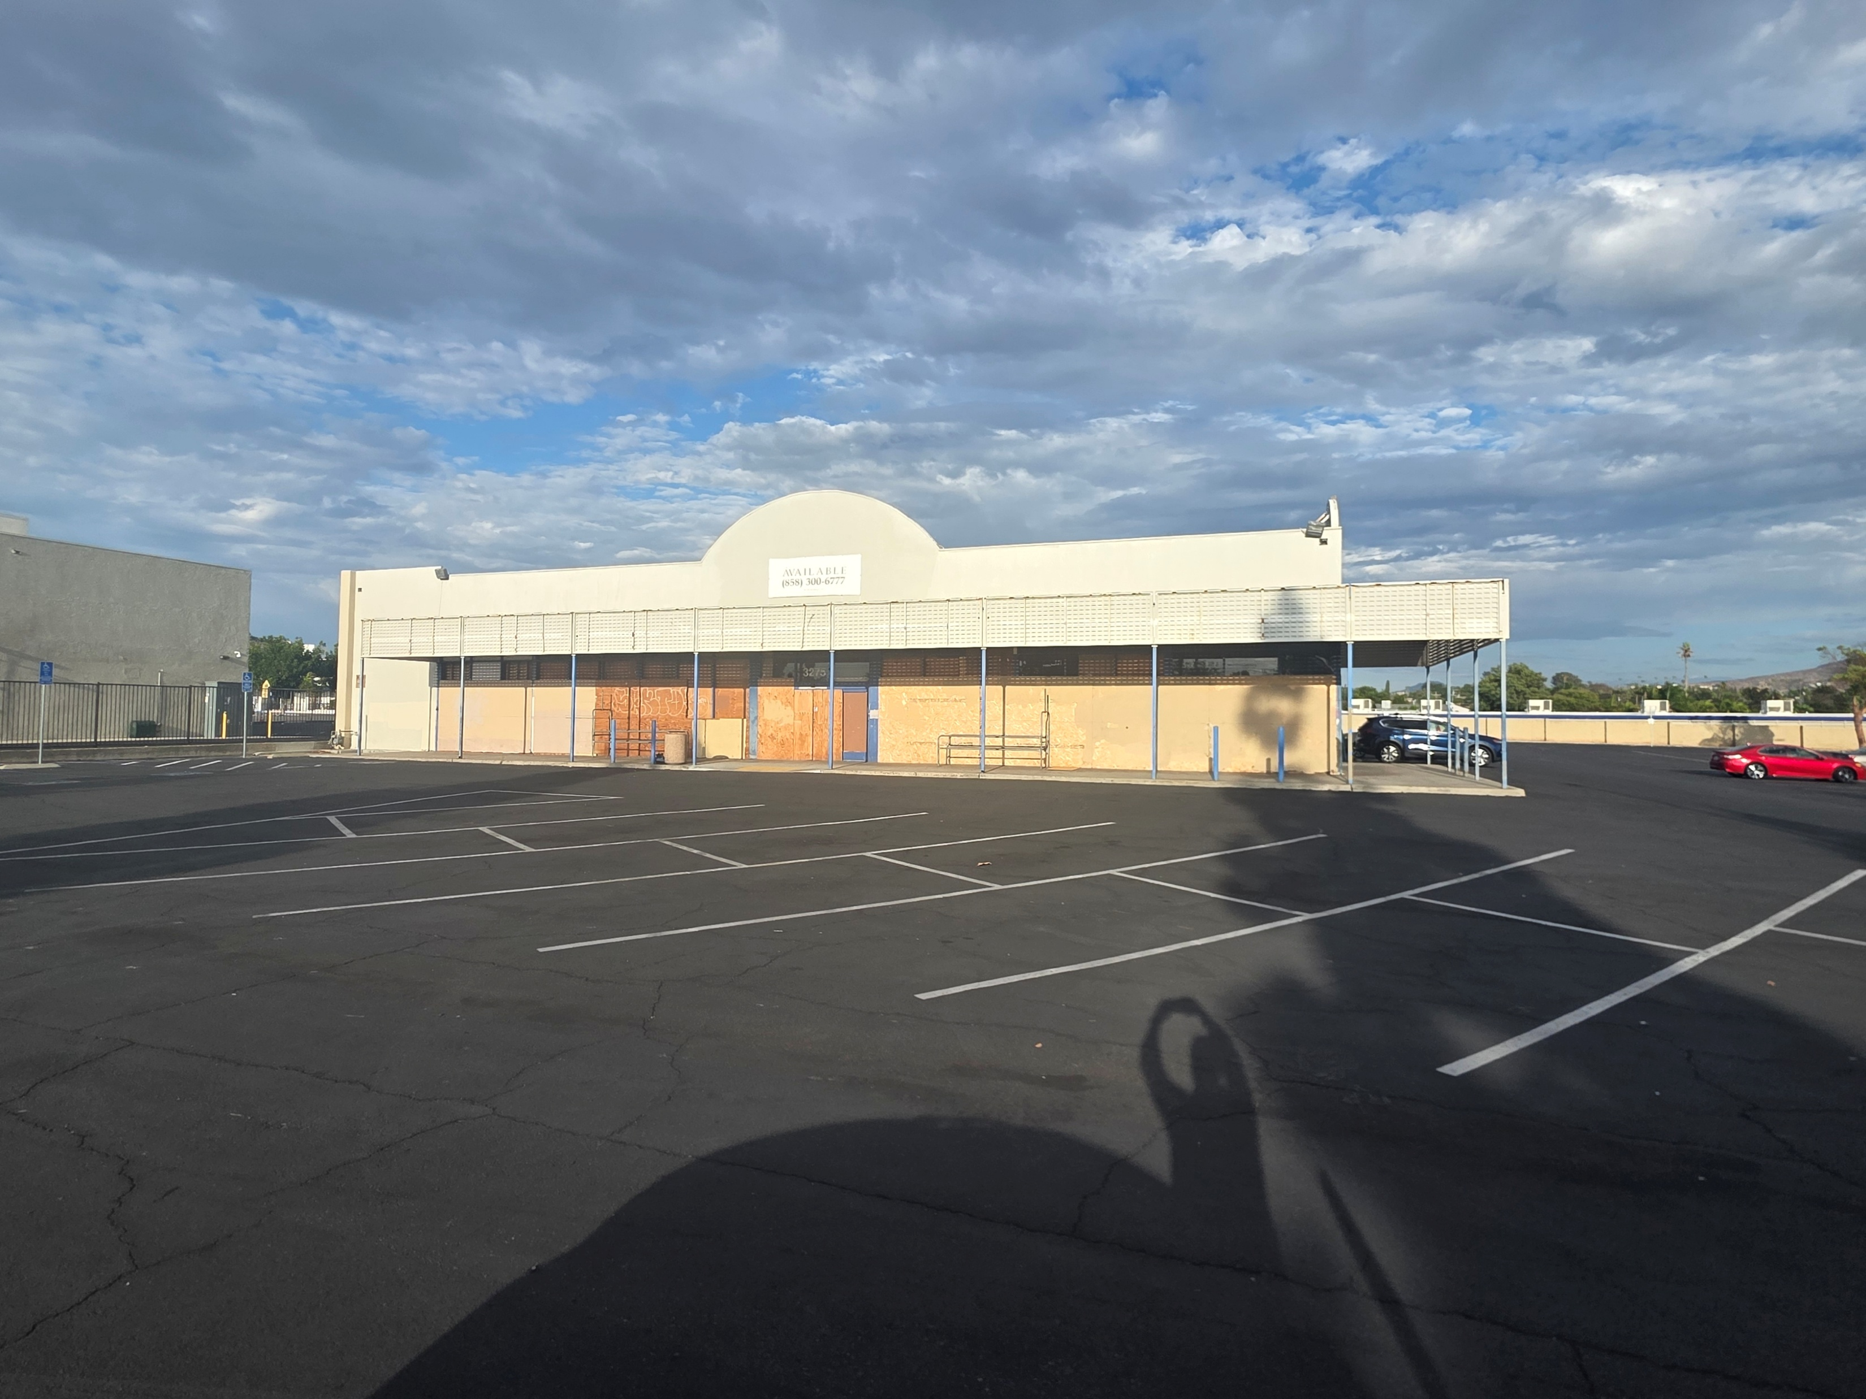
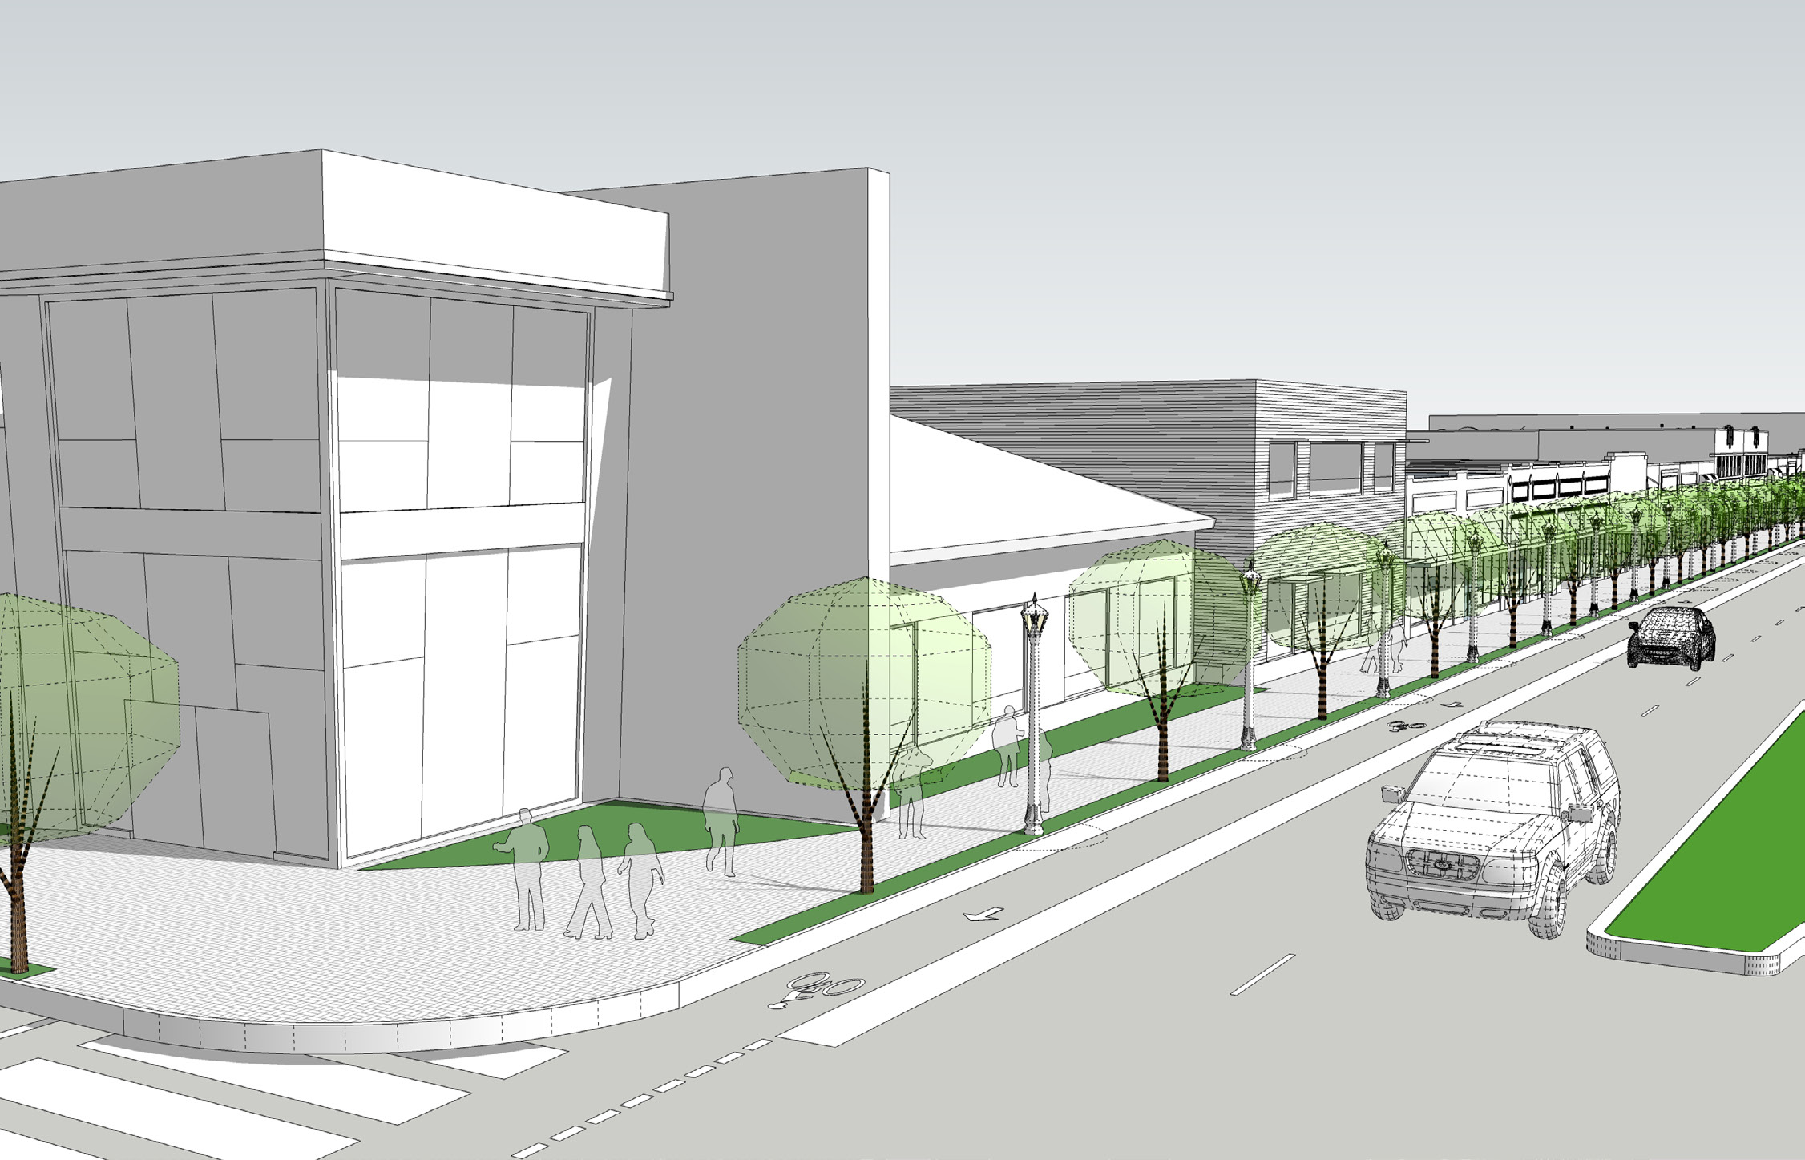
Neighborhood Commercial Zoning District
Maximum Height: 45 ft
Today
Proposed Next Chapter
Notes:
Supports commercial areas that serve Downtown and nearby neighborhoods.
Allows buildings up to 45 feet.
Creates opportunities to improve older, more auto-oriented commercial properties over time.
Businesses and services would remain an important part of the district.
New development could provide better sidewalks, landscaping, and connections to the street.
These illustrations show what the Plan could support, but they are not proposals for these specific properties.
The Plan provides the framework, while actual changes would depend on future property owners, projects, and investment.

Slide 28

Implementing the Vision
Notes:
The Proposed plan includes more than land use regulations and development standards; it also established an implementation framework to guide long-term revitalization efforts.
Implementation strategies focused on programs for economic development, public improvements, as well as funding opportunities, and administrative actions needed to achieve the Plan's vision.
The plan will guide long-term change rather than produce immediate redevelopment. With that being said, after adoption you could see some near term changes such as capital improvement programs, depending on available funding, while others occur over many years.

Slide 29

Next Steps

Slide 30
Downtown’s Next Chapter: Open House
Explore each station at your own pace
Fill in the worksheets at each station
Project team members will be available to answer questions
Notes:
Project team members will be stationed throughout the room and will be happy to answer your questions

Slide 31
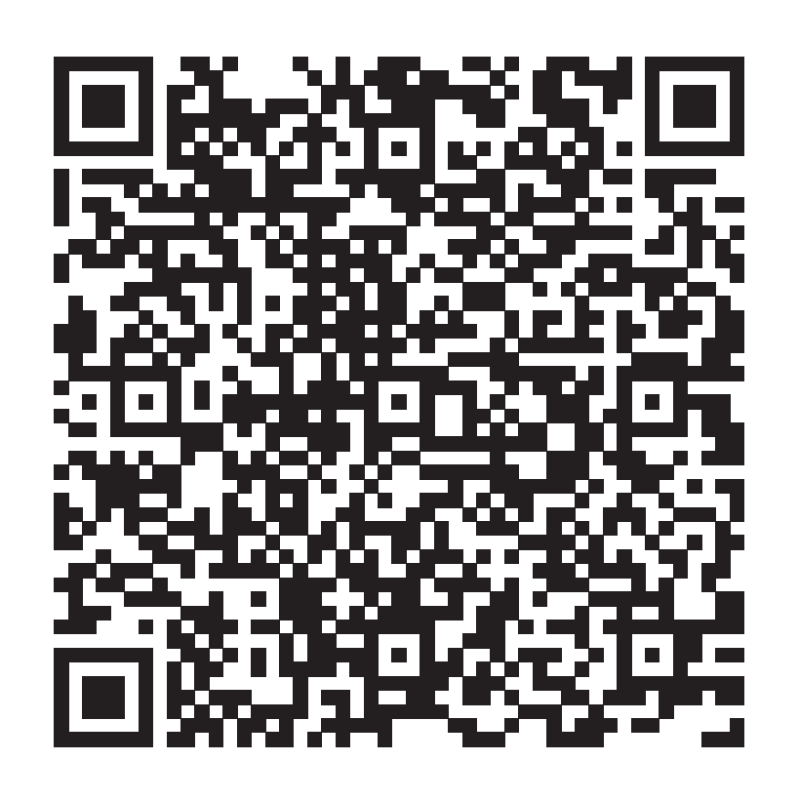
Attend engagement events
Visit project website for updates
SCAN
QR CODE
Scan the QR code to visit the project website.
Notes:
The survey mirrors the questions asked during the open house portion of this evening, feel free to provide additional feedback over the next month if needed
Project update emails

